Slide 1
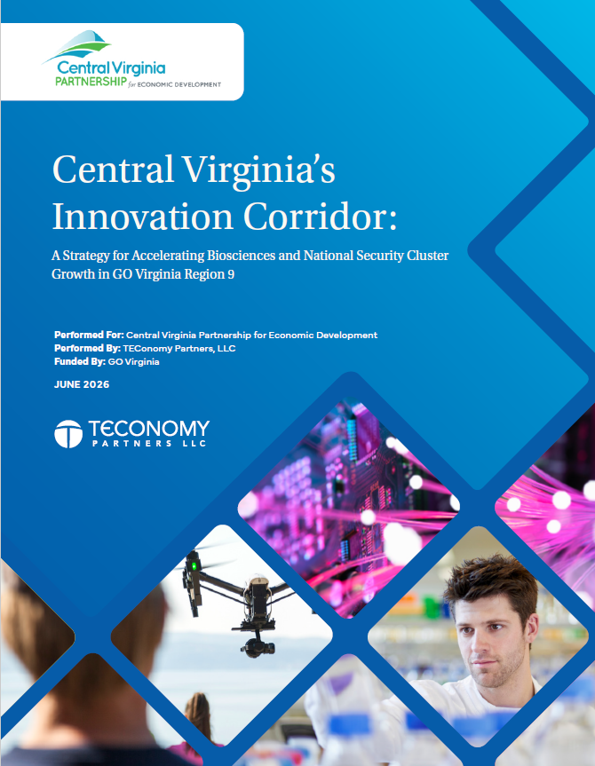
Central Virginia’s Innovation Corridor:
A Strategy for Accelerating Biosciences and National Security Cluster Growth in GO Virginia Region 9
GO Virginia Region 9 Council Meeting
June 16, 2026

Slide 2
Project Workplan Overview
1
Project Kick-off Meeting & Information Gathering
2
Conducting a Quantitative Assessment of Regional Research Institutions’ Industry-Facing Core Competencies in the Biosciences and Digital/IT Domains with Commercial and National Security Applications
3
Conducting a Quantitative Assessment of Regional Advanced Industry Clusters Focused in the Biosciences and Digital/IT Domains with Commercial and National Security Applications
In-Person Mtg.
4
Identification of High-Growth Opportunities
5
Situational Assessment for Regional Development to Inform Strategic Priorities
In-Person Mtg.
6
Preparation of a Strategic Roadmap
= Presentation of interim findings to Project Advisory Coalition.

Slide 3
Stakeholder Input: Interviews, Meetings Conducted to Inform Growth Opportunities, Situational Assessment, Strategic Recommendations
Guidance from a 40-member Advisory Committee, with members strategically selected to reflect leading industry clusters, UVA, federal agencies, and economic development leadership.
  In-person committee meetings and one-on-one interview discussions were held to ensure appropriate feedback and guidance.
One-on-one or small group interviews with 56 regional industry, university, and economic development stakeholders.

Slide 4
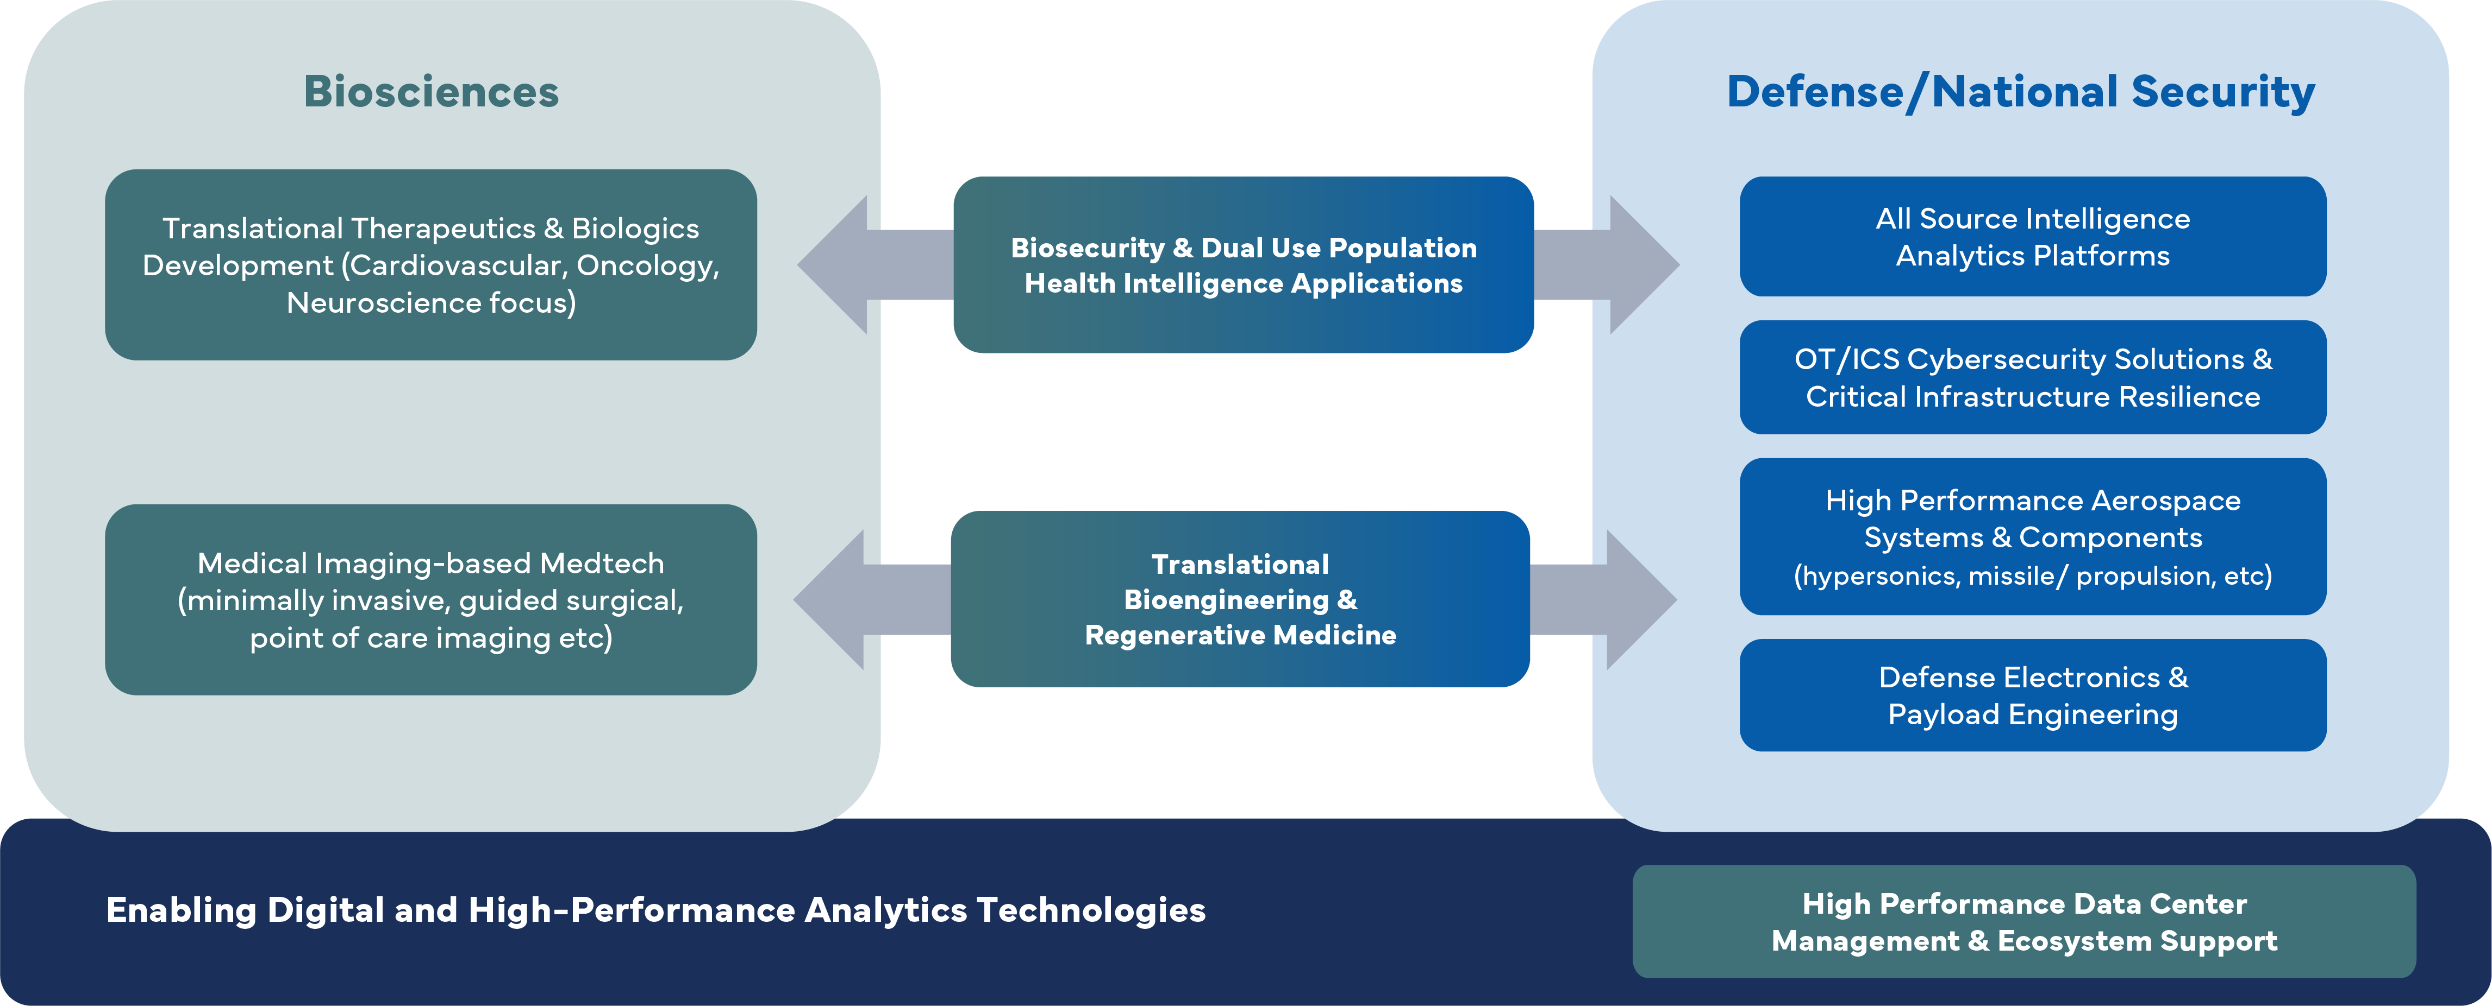
Central Virginia Growth Opportunity Areas Identified in Target Biosciences and National Security Domains
Source: TEConomy analyses.

Slide 5
Strategic Recommendations: Biosciences
Advance the bioscience cluster’s workforce and talent agenda and implement the strategic recommendations set out in the recently published Talent Pathways plan developed with CvilleBioHub as the regional bioscience industry cluster’s leading priority.
Address identified gaps in Central Virginia’s biosciences commercialization continuum, including supporting access to growth capital as a leading priority, to ensure a thriving innovation ecosystem for continued regional cluster development.
Organize regional bioscience cluster-related programming and focused activities around the differentiated priority growth opportunities identified in this strategy; intentionally target and embed these opportunities in existing and new programming and collaborative cluster activities.
Source: TEConomy Partners, LLC forthcoming Central Virginia Innovation Corridor report.

Slide 6
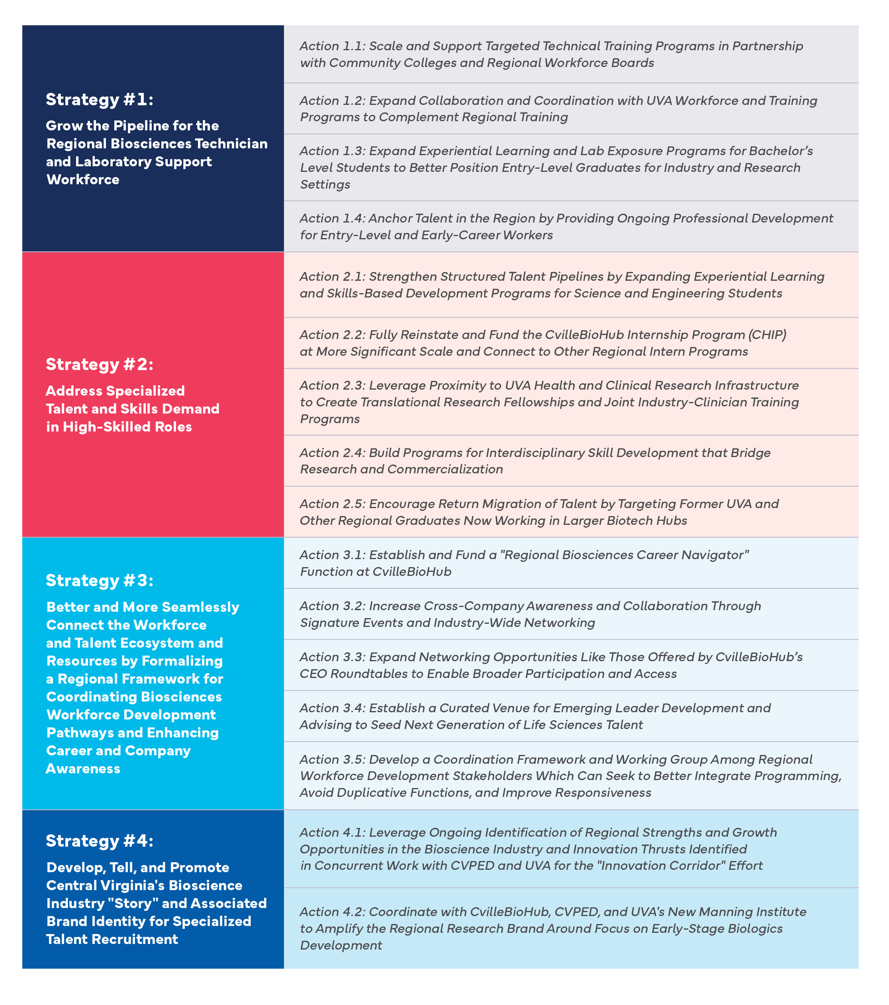
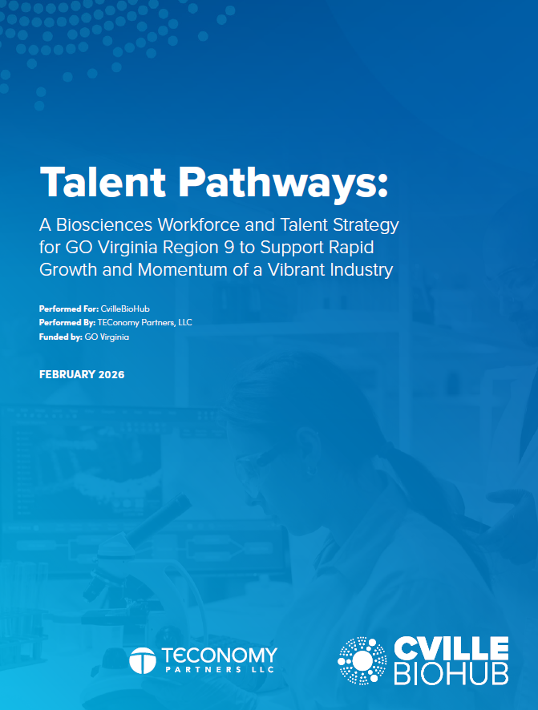
Strategy 1: Advance the Workforce and Talent Agenda and Strategic Recommendations Set Out in CvilleBioHub’s Talent Pathways Plan
Source: TEConomy Partners, LLC, “Talent Pathways: A Biosciences Workforce and Talent Strategy for GO Virginia Region 9 to Support Rapid Growth and Momentum of a Vibrant Industry,” February 2026.

Slide 7
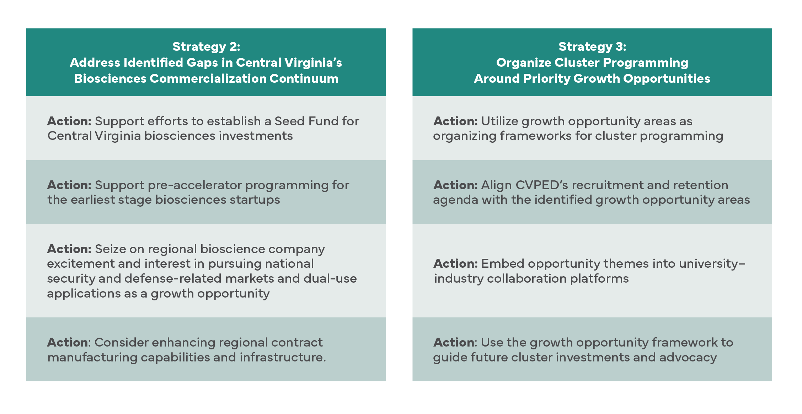
Strategic Recommendations: Biosciences
Source: TEConomy Partners, LLC forthcoming Central Virginia Innovation Corridor report.

Slide 8
Strategic Recommendations: National Security
Programming Support for Building the National Security and Defense Cluster
Establish a Regional Defense Technology Accelerator with Shared Use SCIF and Fabrication Infrastructure
Translational Funds and Support Mechanisms for National Security/Defense Startups and SMEs
Enhance a Robust Talent Pipeline for the National Security Cluster
Further Placemaking for the National Security/Defense Cluster — Co-Location, Defense Facilities Gap Fund, and Innovation District Development
Branding, Outreach, and Business Attraction for the National Security Cluster
Source: TEConomy Partners, LLC forthcoming Central Virginia Innovation Corridor report.

Slide 9
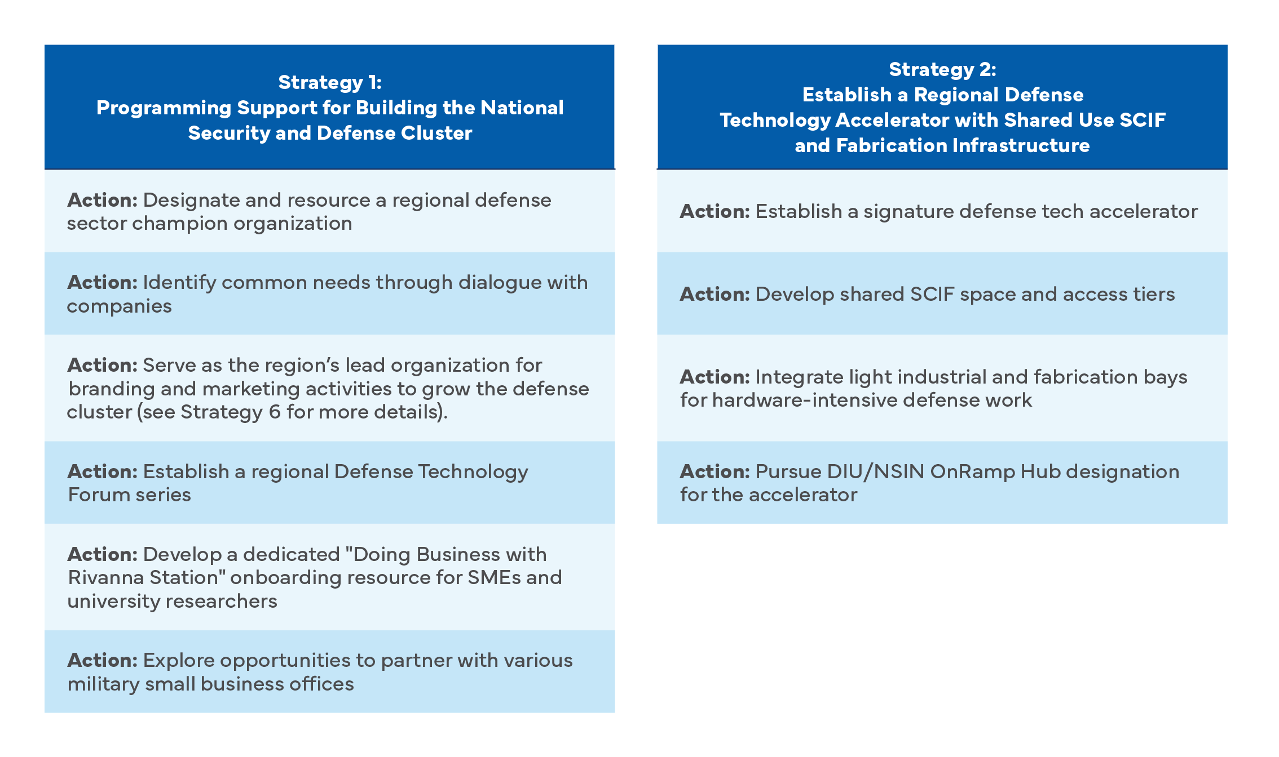
Strategic Recommendations: National Security
Source: TEConomy Partners, LLC forthcoming Central Virginia Innovation Corridor report.

Slide 10
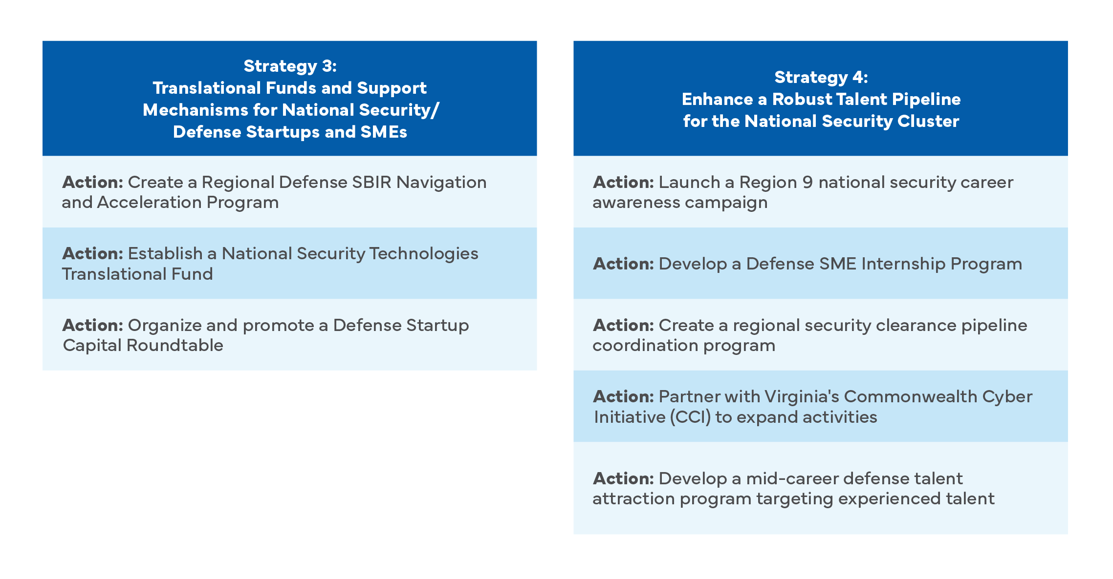
Strategic Recommendations: National Security
Source: TEConomy Partners, LLC forthcoming Central Virginia Innovation Corridor report.

Slide 11
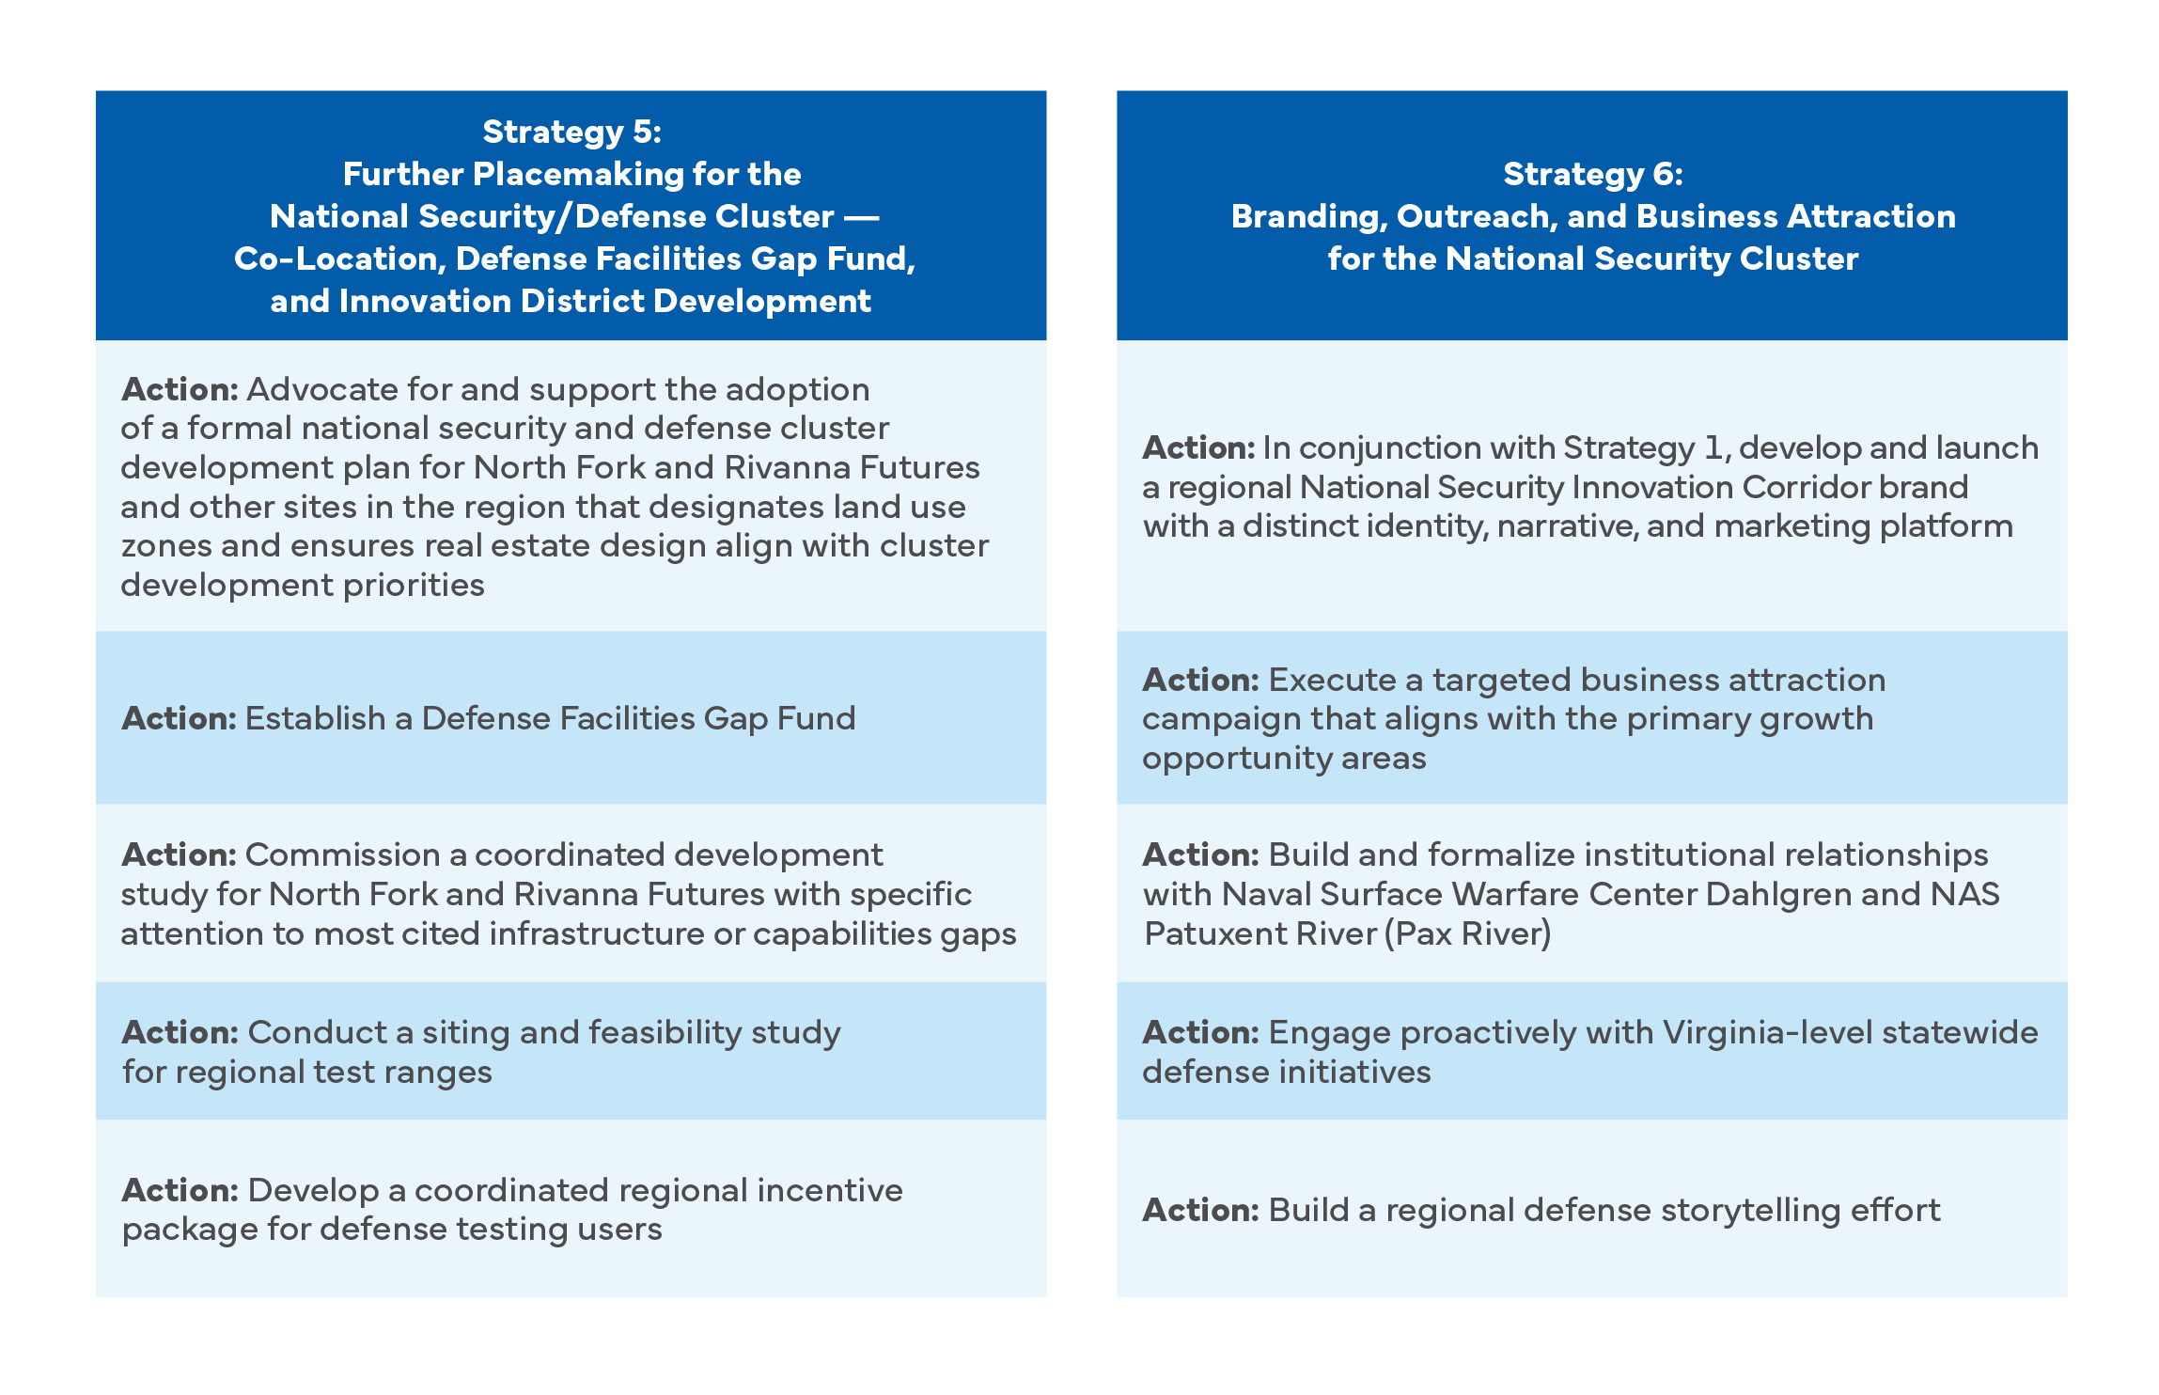
Strategic Recommendations: National Security
Source: TEConomy Partners, LLC forthcoming Central Virginia Innovation Corridor report.

Slide 12
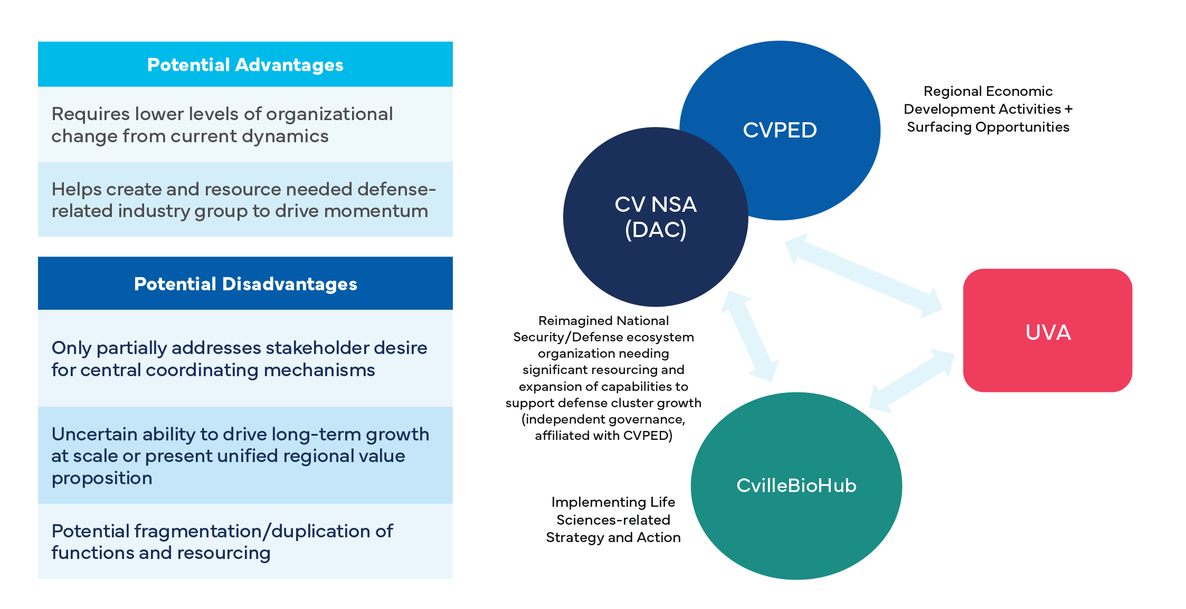
Implementation Considerations: Coordinating Organizational Functions
Option 1 Loose Federation of Existing Organizations Driving Organic Regional Development
Source: TEConomy Partners, LLC forthcoming Central Virginia Innovation Corridor report.

Slide 13
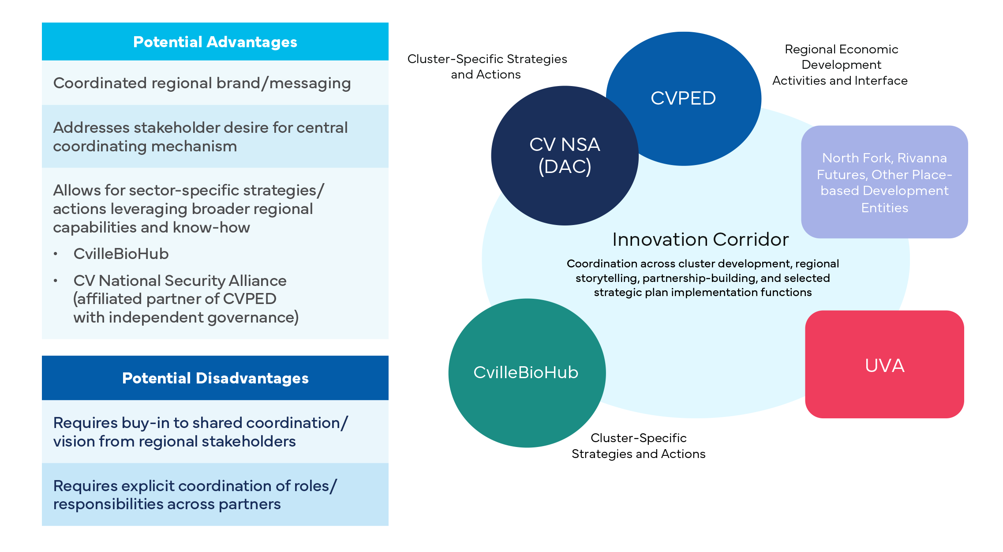
Implementation Considerations: Coordinating Organizational Functions Option 2 Innovation Corridor as an Organizing Construct
Source: TEConomy Partners, LLC forthcoming Central Virginia Innovation Corridor report.

