Slide 1
GO Virginia Program Updates
August 8, 2023
Joseph Dennie
Joseph.dennie@dhcd.virginia.gov

Slide 2
GO Virginia Match Requirements – Per Capita Funds
History
April 2020 - State Board eased match requirements due to the fiscal/economic distress caused by the pandemic
Staff issued administrative guidance on Meaningful Local Participation
Relaxed Match policy extended in September 2020 and again in April 2021

Slide 3
GO Virginia Match Requirements – Per Capita Funds
State Code: TOTAL MATCH
§ 2.2-2489. Award of grants to regional councils.
K. (Effective July 1, 2023) Any grant awarded from the Fund to a regional council shall require matching funds at least equal to the grant, provided, however, that the Board shall have the authority to reduce the match requirement to no less than half of the grant upon a finding by the Board of fiscal distress or an exceptional economic opportunity in a region. Such matching funds may be from local, regional, federal, or private funds, but shall not include any state general or nongeneral funds, from whatever source.

Slide 4
GO Virginia Match Requirements – Per Capita Funds
Board Policy: LOCAL MATCH
In September 2017, the State Board established the local match requirement to reinforce the importance of regional collaboration and commitment to the project through demonstration of cost sharing. The guidance states “Those matching funds should include a local contribution of not less than 20% of the required $1:1 match, or $50,000 whichever is greater.”
The Virginia Growth and Opportunity Act defines “regional activity” as follows:
"Regional activity" means an economic or workforce development-focused collaborative project or program that is (i) endorsed by a regional council, (ii) consistent with the economic growth and diversification plan developed by the regional council, and (iii) carried out, performed on behalf of, or contracted for by two or more localities, political subdivisions, or public bodies corporate and politic within a region.

Slide 5
GO VIRGINIA Per Capita Fund – Pre-October 2023
 | Original (Pre-Pandemic) |  | Relaxed Match Policy (Expires October 1, 2023)
Project Type | Total Match | Local Match | Total Match | Local Match
Enhanced Capacity Building (planning, pilots and feasibility studies) | 1-1 | No Local Match Required | 2-1 | No Local Match Required
Regional Entrepreneurship Initiative | 2-1 | No Local Match Required | 2-1 | No Local Match Required
Sites (planning) | 1-1 | No Local Match Required | 2-1 | No Local Match Required
Broadband (planning) | 2-1 | No Local Match Required | 2-1 | No Local Match Required
Per Capita Project Implementation | 1-1 | 20% or $50,000, whichever is greater. | 2-1 | No Local Match Required

Slide 6
GO Virginia Match Requirements – Per Capita Funds – Post October 1, 2023
Project Type | Total Match | Local Match
Enhanced Capacity Building (planning, pilots and feasibility studies) | 1-1 | No Local Match Required
Regional Entrepreneurship Initiative (planning) | 2-1 | No Local Match Required
Sites (planning) | 1-1 | No Local Match Required
Broadband (planning) | 2-1 | No Local Match Required
Per Capita Project Implementation | 1-1 | 20% of required match
Return to original Total Match requirements by project type
Reinstate Local Match requirement, but eliminate the $50,000 min.
2-1 Total Match for most planning grants
1-1 Total Match for Implementation projects
Local Match required for implementation projects.
Implement Waiver request Process for Total and Local Match

Slide 7
GO Virginia Match Requirements – Per Capita Funds –Implementation Strategy
Enact a Waiver Process for TOTAL MATCH
Objective criteria - “Fiscal Distress” or “Extraordinary Economic Opportunity”
Enact a Waiver Process for LOCAL MATCH
Objective criteria - localities ability to contribute
Delayed enactment – October 1, 2023
Waiver process will be developed and presented to the Board at the September 12, 2023 meeting

Slide 8
Proposed Waiver Process for TOTAL Match Reduction – Fiscal Distress
Enact an objective waiver process for “fiscal distress” to reduce match required to 2-1 for projects where the following factors may be considered:
At least 50% of the participating localities meet the Virginia Economic Development Partnership’s definition for Economic Distress – Double Distress and will promote job and wage growth.

Slide 9
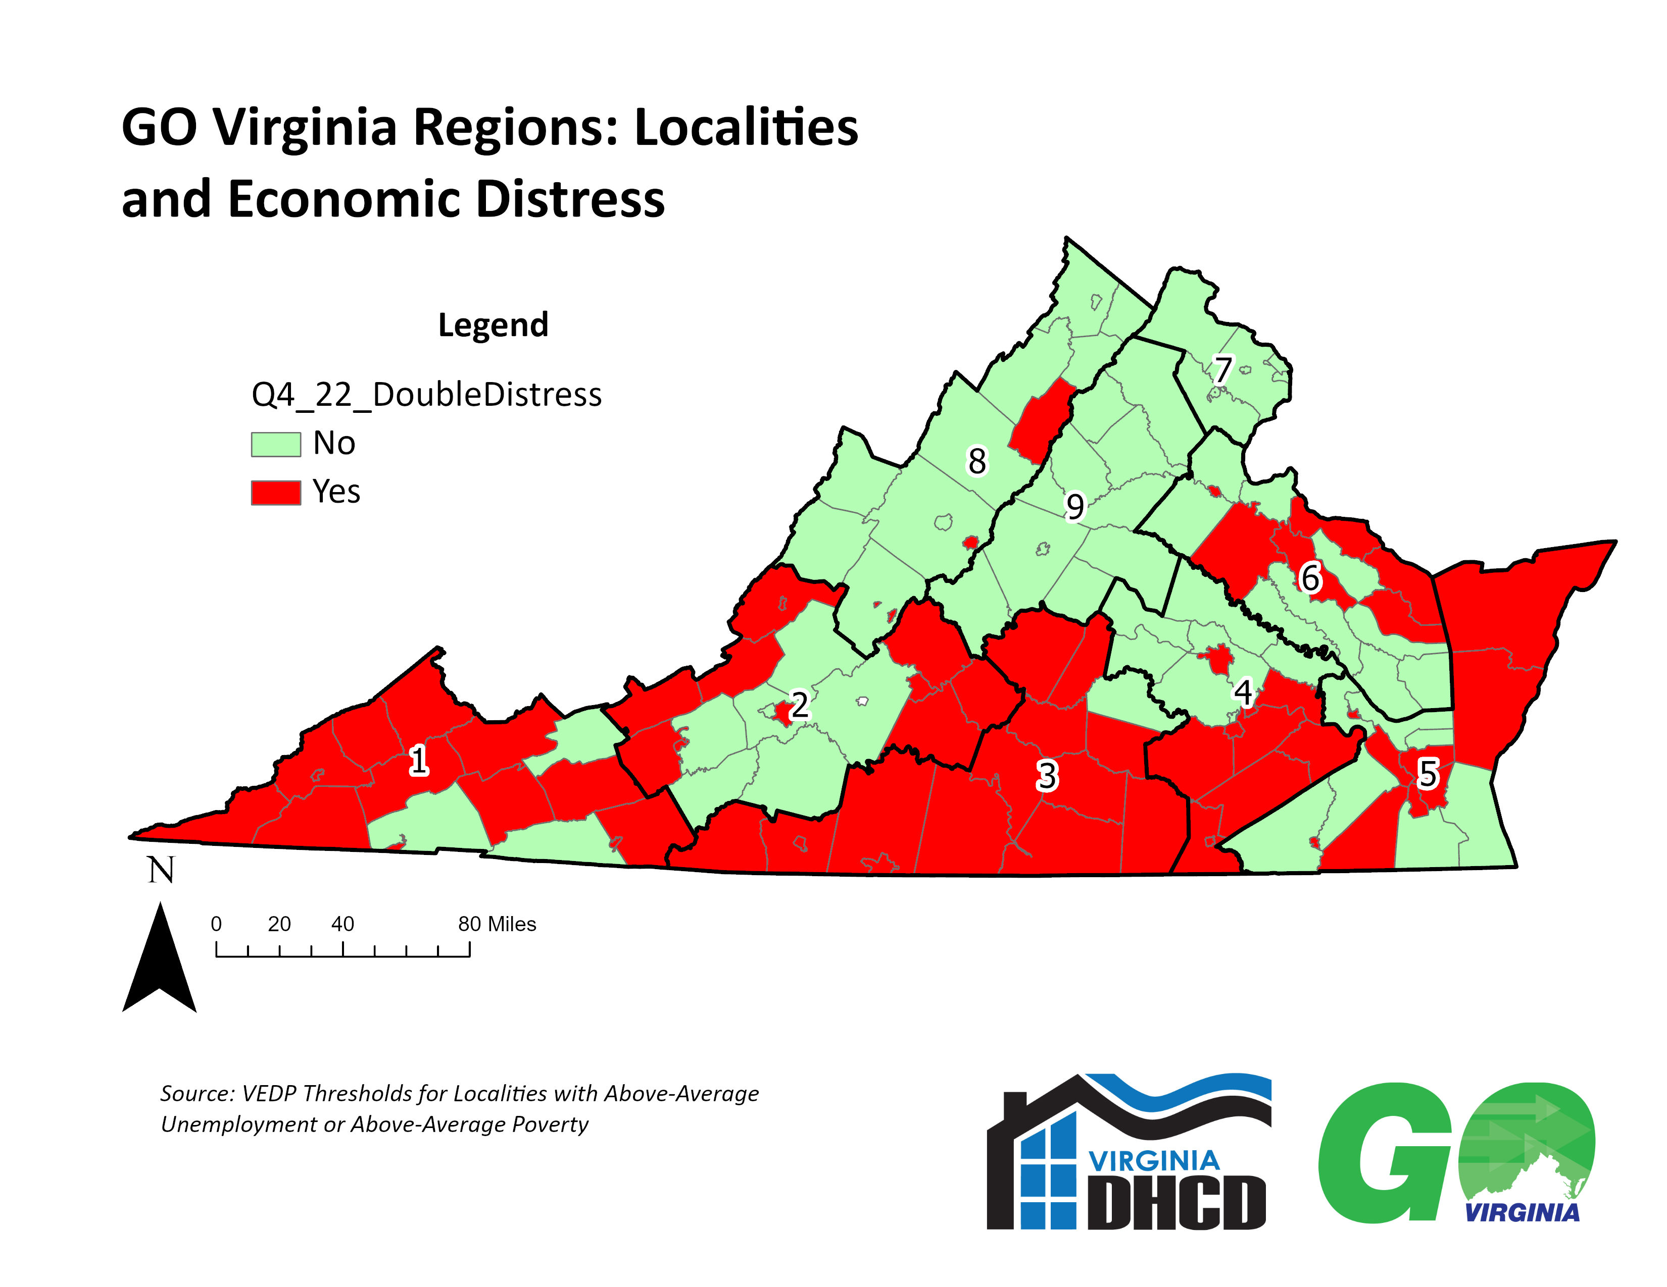
Source: VEDP Thresholds for Localities with Above-Average Unemployment and Above-Average Poverty.

Slide 10
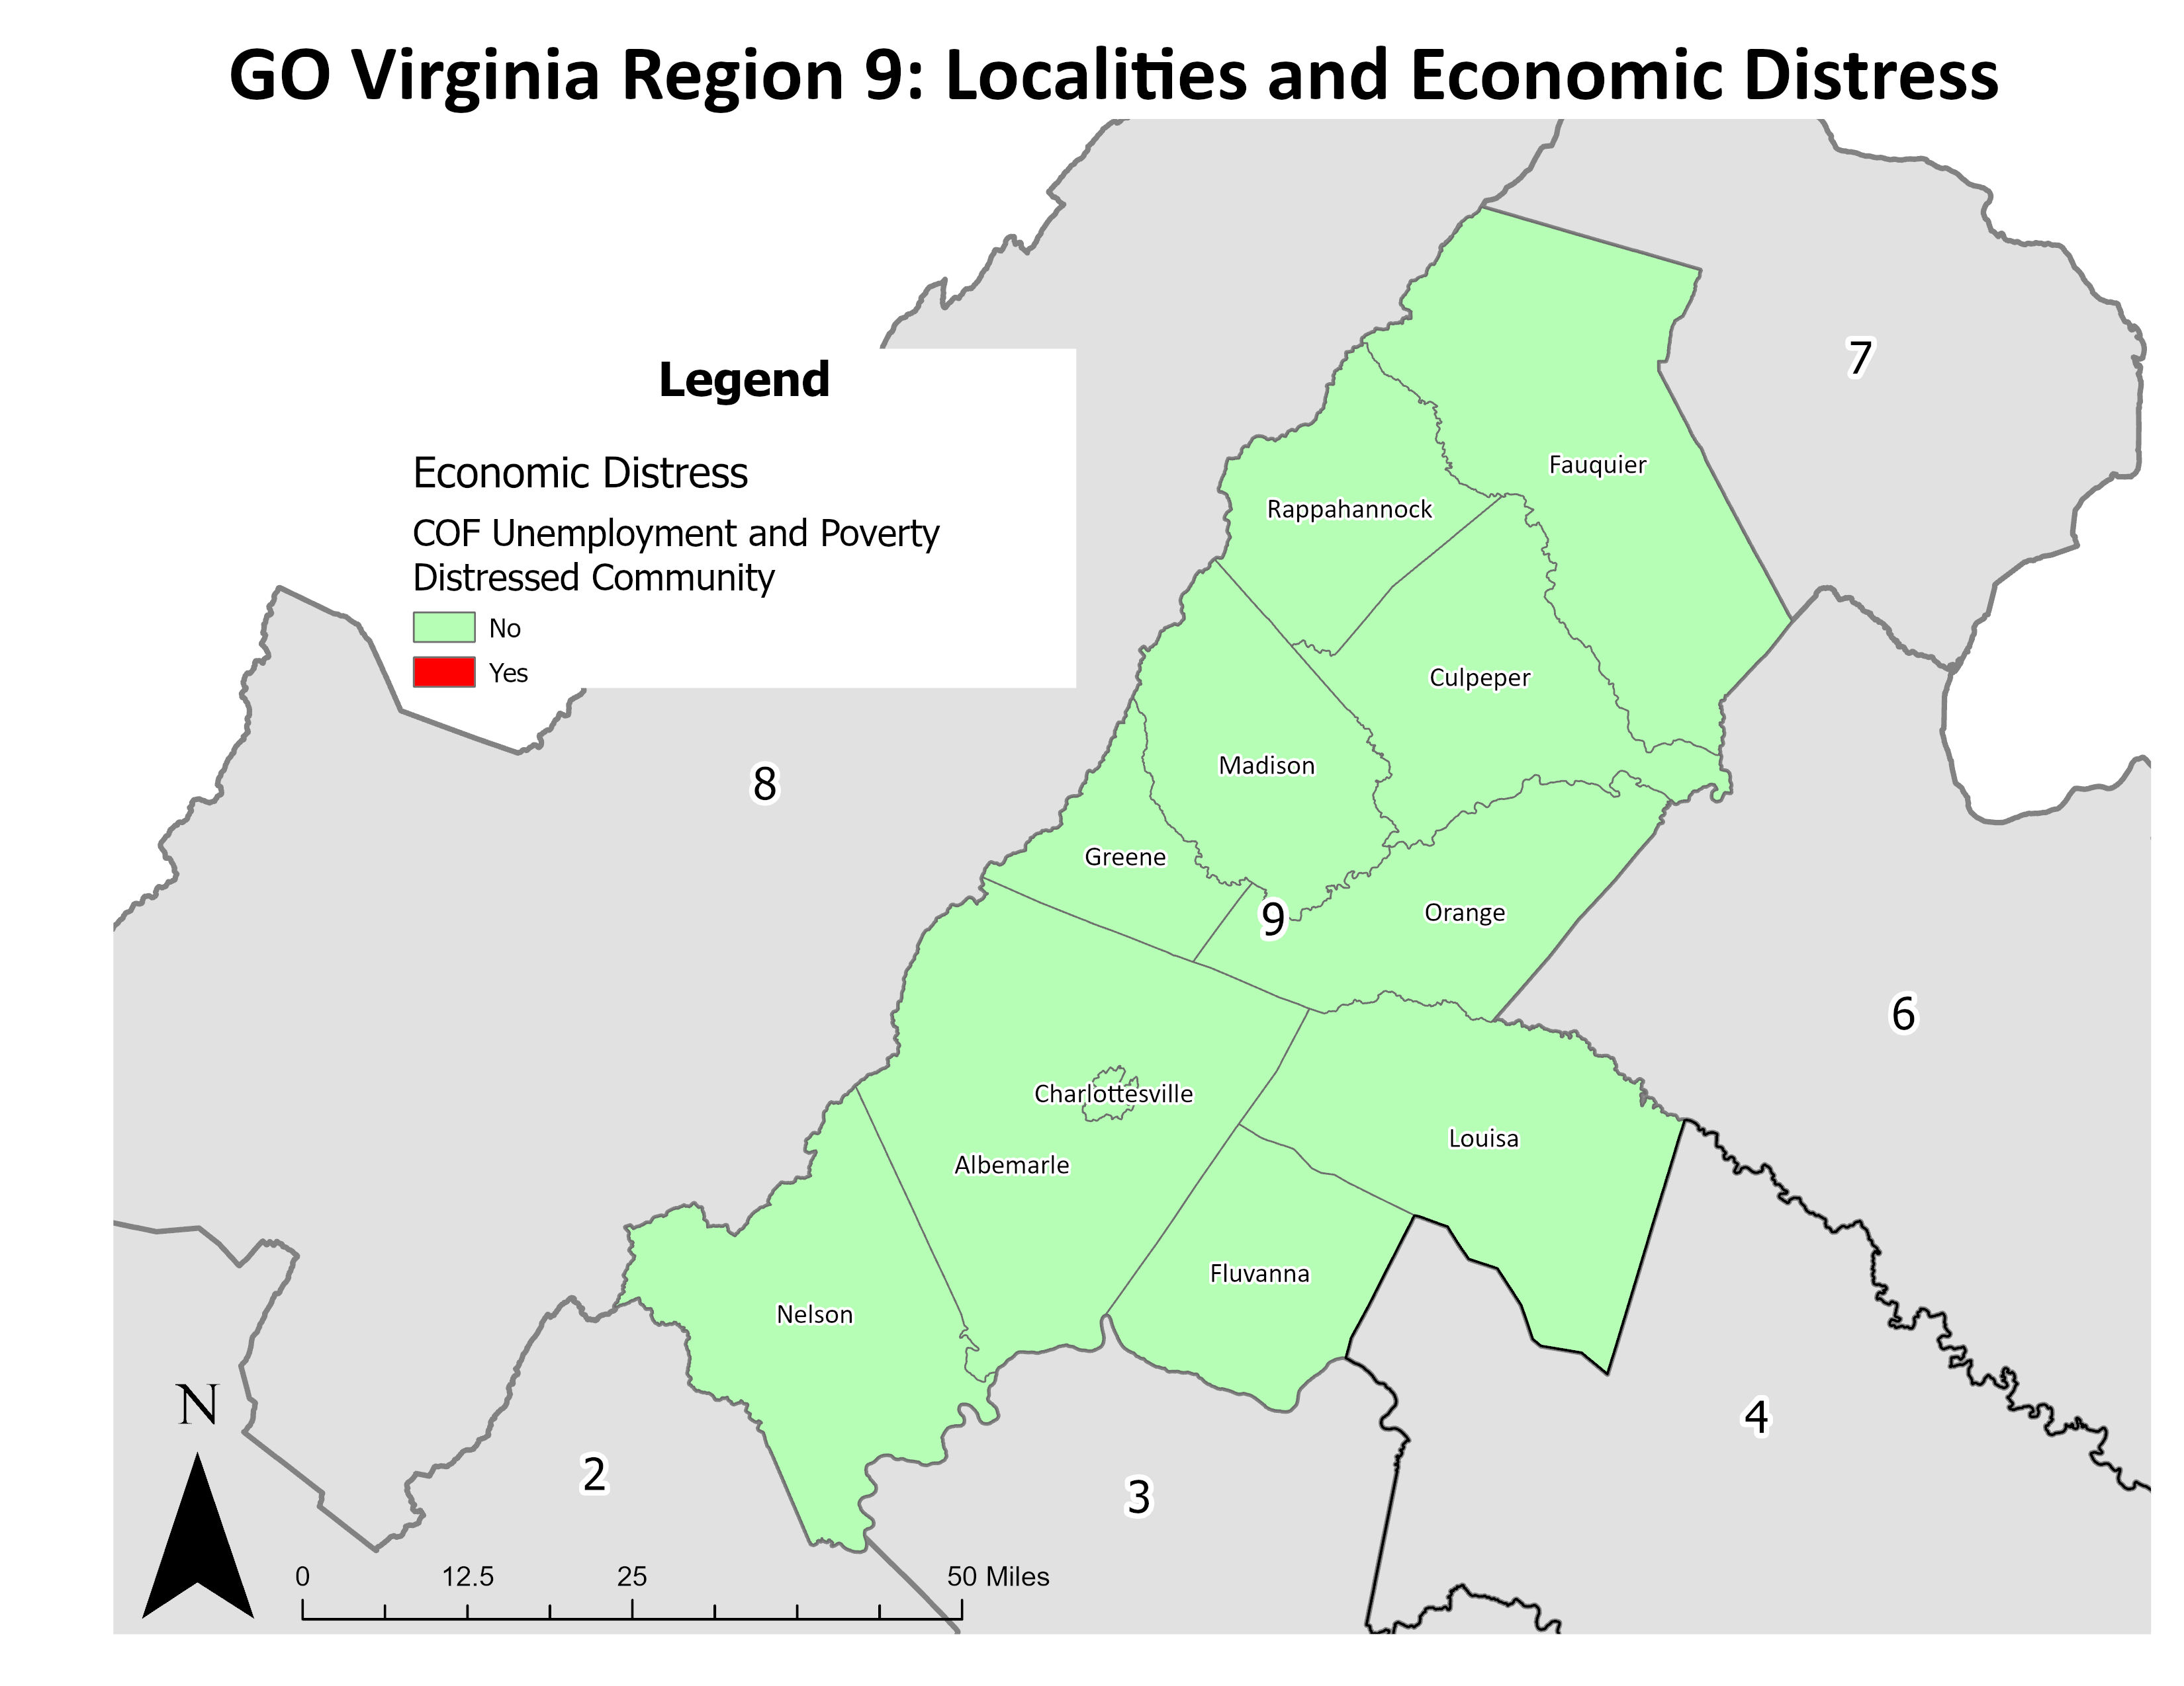
Source: VEDP Thresholds for Localities with Above-Average Unemployment and Above-Average Poverty.

Slide 11
Proposed Waiver Process for TOTAL Match Reduction – Extraordinary Economic Opportunity
An application demonstrates strong alignment with the GO Virginia Program through one or more of the following methods:
The majority of the match being contributed is local match (cash or in-kind)
The majority of the match contributions for this effort are being contributed by industry partners
The project will increase employment in the industry cluster over a base, as described in the Regional G&D Plan
The project will lead to growth in a new or emerging industry cluster with potential to significantly diversify the regional economy

Slide 12
Proposed Waiver Process for TOTAL Match Reduction – Extraordinary Economic Opportunity
An application aligns with the Commonwealth’s InnoVAtive Framework for Economic Development and will support the expansion of the knowledge sector, manufacturing, or logistics industries.
An application will enable the subgrantee to leverage the award to pursue a nonstate funding opportunity in an amount at least two times the amount of the GO Virginia grant requested.

Slide 13
Proposed Waiver Process for LOCAL Match Reduction
Enact an objective waiver process for “fiscal stress” or “demonstrated inability to establish local match” to eliminate or reduce match required local match for projects via the following criteria:
At least 50% of the participating localities are classified as having High or Above Average Fiscal Stress, as measured by the Fiscal Stress Index
The participating localities have demonstrated that the applicant has attempted to solicit the local match contribution but that the localities are unable to provide it
This effort must be described by each participating locality via a letter of support verifying the inability to contribute

Slide 14
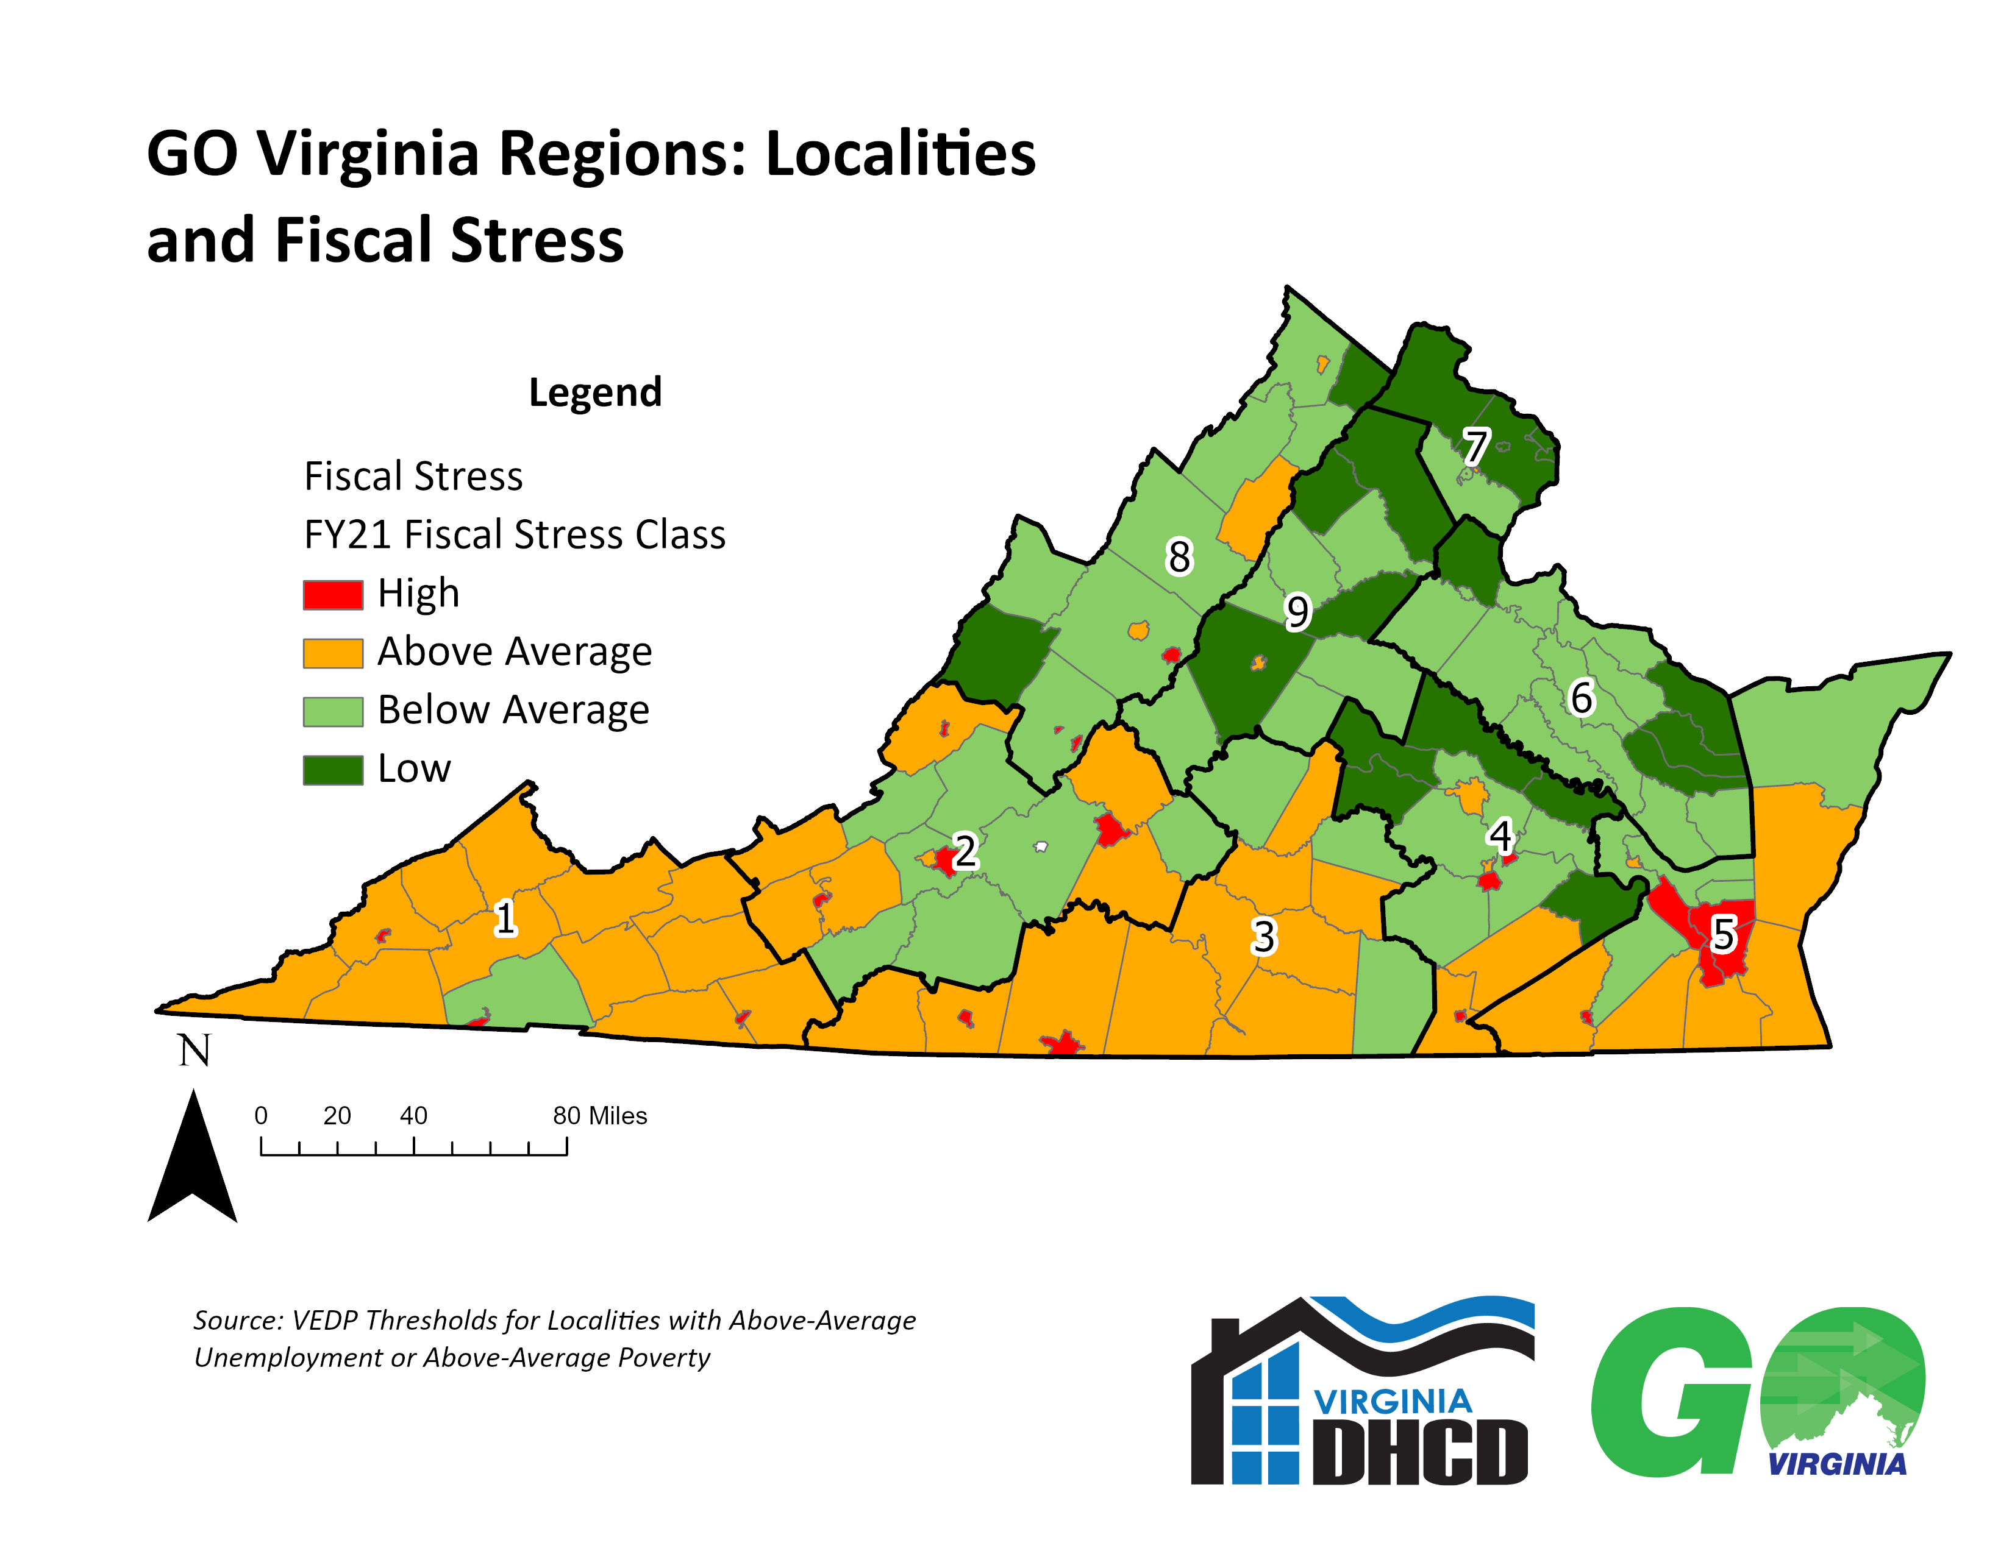
Source: DHCD Comparative Revenue Capacity, Revenue Effort, and Fiscal Stress of Virginia's Cities and Counties, FY2021

Slide 15
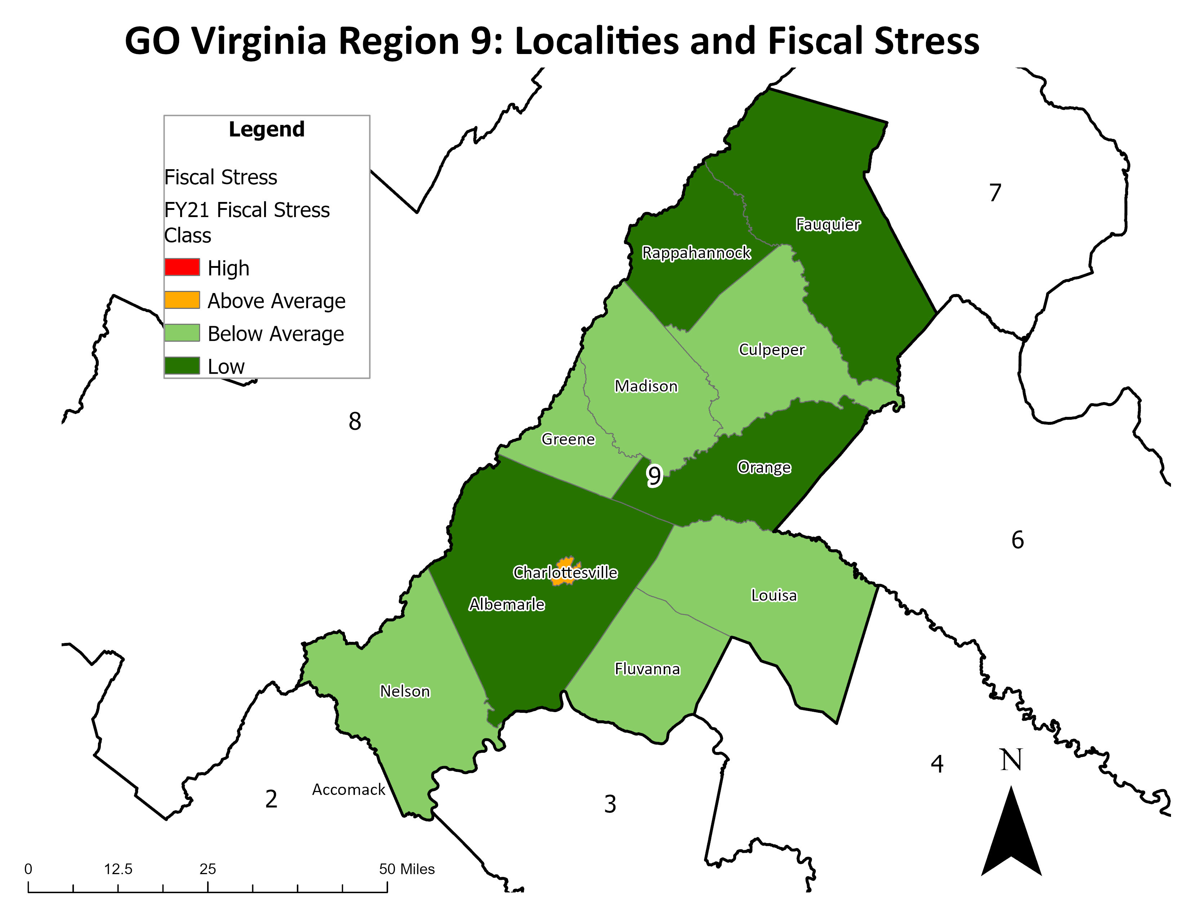
Source: DHCD Comparative Revenue Capacity, Revenue Effort, and Fiscal Stress of Virginia's Cities and Counties, FY2021

Slide 16
Fiscal Stress Index
The fiscal stress index illustrates a locality’s ability to generate additional local revenues from its current tax base relative to the rest of the Commonwealth based on three components:
Revenue capacity per capita – or the theoretical ability of a locality to raise revenue
Revenue effort – or the amount of theoretical revenue capacity that the locality actually collects through taxes and fees
Median household income

Slide 17
GO VIRGINIA Per Capita Fund Summary
 | Before April 2020 |  | After October 1, 2023
Project Type | Total Match | Local Match | Total Match | Local Match
Enhanced Capacity Building (planning, pilots and feasibility studies) | 1-1 | No Local Match Required | 1-1 | No Local Match Required
Regional Entrepreneurship Initiative (planning) | 2-1 | No Local Match Required | 2-1 | No Local Match Required
Sites (planning) | 1-1 | No Local Match Required | 1-1 | No Local Match Required
Broadband (planning) | 2-1 | No Local Match Required | 2-1 | No Local Match Required
Project Implementation | 1-1 | 20% or $50,000, whichever is greater. | 1-1 | 20% of Total Match

