Slide 1




Final Framework and Report
GO Virginia Region 9
Robert Camoin
President & CEO
In collaboration with:
Thomas P. Miller and Associates
Innovation PolicyWorks
Global Location Strategies
Prepared for: GO Virginia Region 9 Council
Date: September 13, 2017
Notes:
Why are we here?
Work complete, engaged stakeholders (100+), plan submitted
Public meeting to get the word out
Plan is not a full strategic plan, a framework only
Now we look for project
So, meeting is in part to solicit good projects that fit the framework

Slide 2
Agenda
Overview of Data and Targeted Industries
Framework Initiatives
Question and Answer
GO Virginia
Talent Development
Growing Existing Businesses
Startups/Innovation/Commercialization
Sites
Other Opportunities
Project Application Process
I
II
III
IV
V
VI
Notes:
Brian Cole to open meeting
Rob to do PPT
Helen to explain how applications will flow

Slide 3

Economic Growth and Diversification Plan
Notes:
What is GO Virginia?
Initiative 2 years in the making, The way forward in the field of economic development, Regionalizing economic development efforts
Greater collaboration and coordination
Combining resources for greater impact
Examples in NC, MI, NY, SC
Why should you care?
More and more money will be funneled thru GOVA
More and more of the decision making will happen at the regional level
Time to get in the game, take a seat at the table, and work as a region

Slide 4
Project Schedule
Phase | Task # | Task Name | Current Progress
I: Baseline Assessment | 1 | Project Kickoff | Complete
 | 2 | Meeting with Council | Complete
 | 3 | Business/Industry Survey | Complete
 | 4 | Economic Base Analysis | Complete
 | 5 | Workforce Data Analysis | Complete
 | 6 | Innovation Asset Inventory | Complete
 | 7 | Desktop-level Site Evaluation | Complete
II: Competitive Positioning | 8 | Preliminary Targeted Industries | Complete
 | 9 | Report to Council | Complete
 | 10 | Interviews, Focus Groups, Field Audits | Complete
 | 11 | Additional Research | Complete
 | 12 | Final Targeted Industries | Complete
III: Framework Development | 13 | Report Out to Council | Complete
 | 14 | Finalize and Submit Plan | Complete
 | 15 | Post-Plan Presentation | Today
Notes:
Very briefly describe the work that was completed. Focus on stakeholder engagement (100+) plus business survey.
Work that was done to identify the framework:
Business survey
Economic analysis – past and projected
Workforce – occupations, labor skills vs. demands
Inventory of innovation assets – because to remain healthy, regional economies need to create an environment in which new businesses and industries can thrive
Inventory and assessment of commercial and industrial sites
Interviews with business leaders, public officials, economic development and workforce officials, and numerous stakeholders
Identification of competitive industries

Slide 5
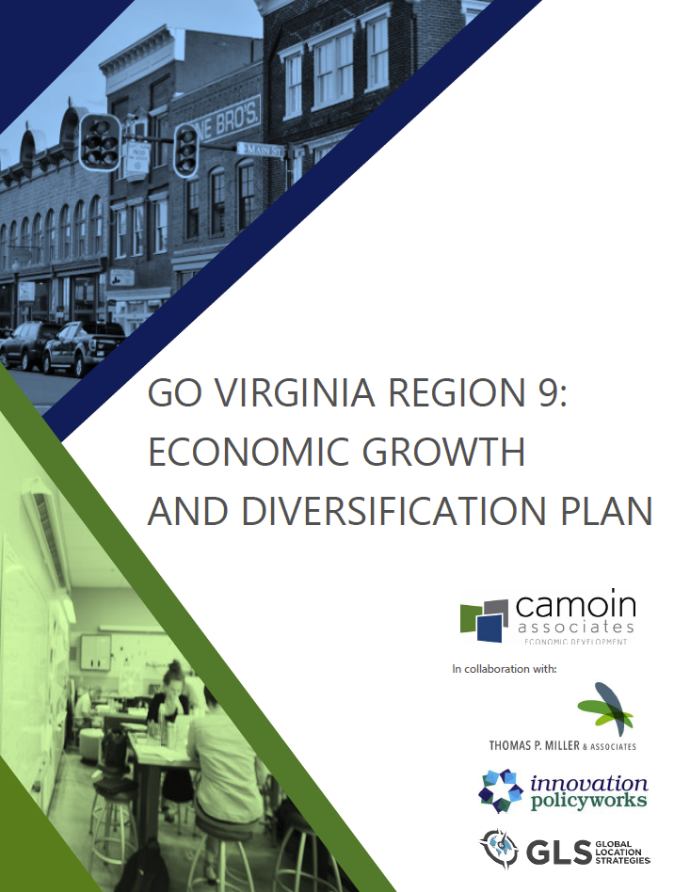
Completed Plan
Plan has been completed and submitted to the state for approval
Recognition and congratulation to all stakeholders who contributed
Finalized Framework Initiatives will be detailed today
Notes:
326 pages.
Herculean
DHCD has reviewed, very minor edits submitted
Expect approval

Slide 6
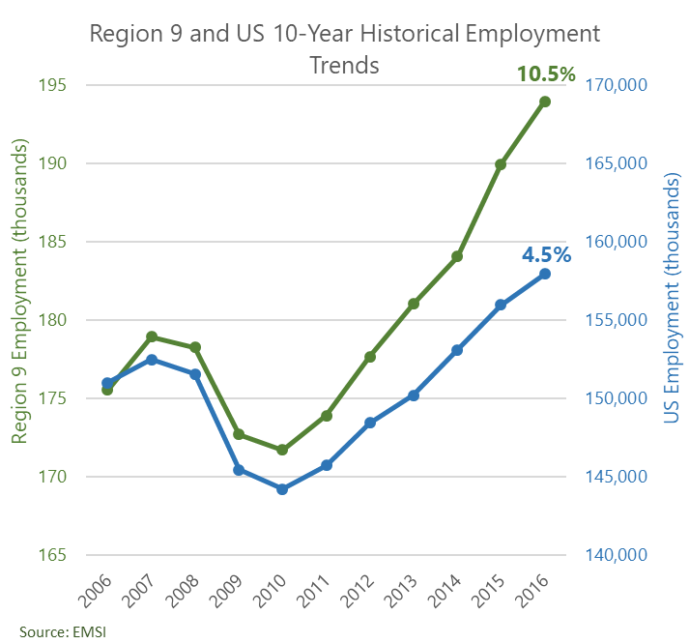
Economic Base Analysis
Notes:
You lost 7,000 jobs during the recession, but region grew by 18,500 jobs or (10.5%) in the last ten years, outpacing the rest of the country which grew at 4.5%
So one might look at that and say, hey we are ok.
But here is where there is concern:
All the growth occurred in the Thomas Jefferson Planning area
And there is still significant job loss in blue collar positions
You now have a very different job mix.
Region is projected to grow another 28,800 jobs or 15% over the next 10 years!!

Slide 7
County by County Trends
Notes:
Don’t try to interpret – we just want you to know that we are looking at industries by County
Since 2006 your economy is down almost 8,000 jobs in construction, manufacturing and wholesale and has increased almost 10,000 jobs in industries that require advanced degrees
Manufacturing still down 1,000 jobs for the region, and was down everywhere except in Nelson and Orange
Lost 1/3 of your workforce in construction which is down everywhere
Vast majority of job expansion happened in just Albemarle/Charlottesville (plus Louisa County), biggest chunk of that was education (public university).
Your economy is becoming very homogenous
GO VA is about growth and diversification

Slide 8
Targeted Industries
Notes:
An important component of GOV was to get regions to focus on their competitive industries.
Targeted Sectors:
IT/Communications
Bio-medical & Life Sciences
Finance & Business Services
Food & Beverage Manufacturing
Light Manufacturing

Slide 9
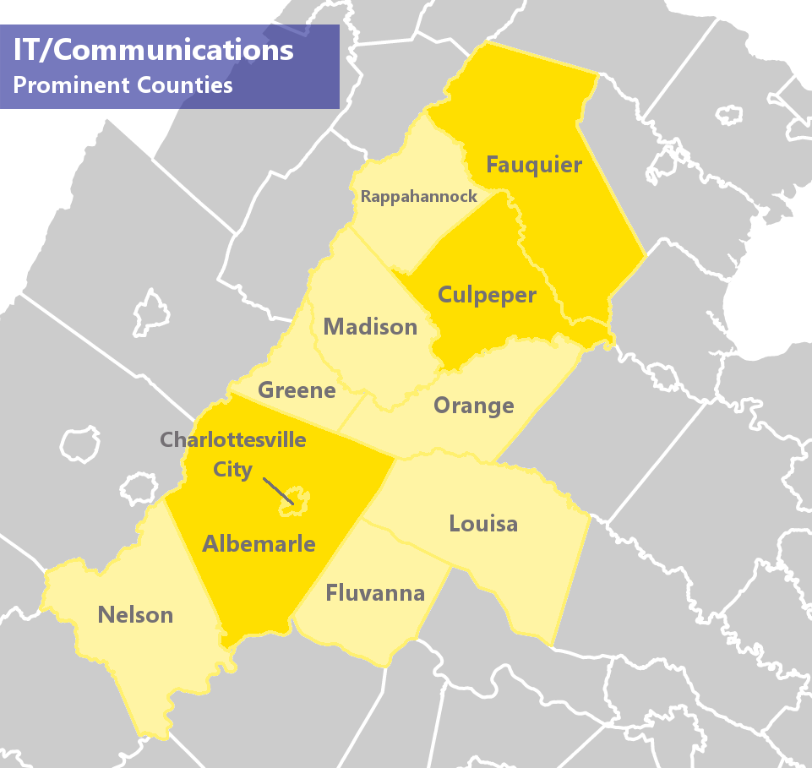
Notes:
Lots of nearby IT growth – NOVA and other counties, huge federal demand. We are seeing this spread out.
National growth
High wage, growing and already prevalent, innovation economy and aligned politically – what people want.
Culpeper – already has an existing data center
Fauquier has the talent base – commutation patterns
Albemarle – a lot of small company formation and IT assets as well
OBSTACLE: need better broadband, cell service and good office sites/buildings
EXAMPLES OF SUBSECTORS IN THIS INDUSTRY: Computer Systems Design and Related Services, Building Equipment Contractors, Management, Scientific, and Technical Consulting Services, Scientific Research and Development Services, Navigational, Measuring, Electromedical, and Control Instruments Manufacturing, Wired Telecommunications Carriers, Data Processing, Hosting, and Related Services, Software Publishers, Household Appliances and Electronic Goods Merchant Wholesalers, Industrial Machinery Manufacturing, Electrical Equipment Manufacturing,

Slide 10
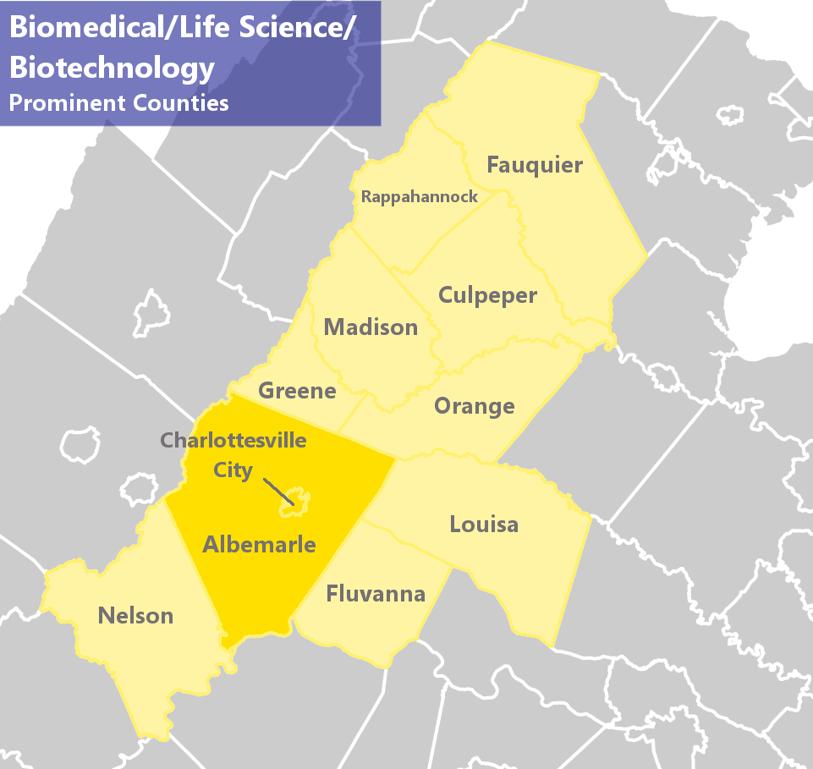
Notes:
UVA driving a huge amount of intellectual property with spin offs. Burgeoning cluster with talent and research happening at UVA. Greater investment amounts are expected
This is the only location for Biomedical Technology
Fits in well with Eds and Meds brand of the region
High paying, innovation based, exporting, growing across country
EXAMPLES OF SUBSECTORS IN THIS INDUSTRY: Pharmaceutical and Medicine Manufacturing, Commercial and Service Industry Machinery Manufacturing, Navigational, Measuring, Electromedical, and Control Instruments Manufacturing, Industrial Machinery Manufacturing, Medical Equipment and Supplies Manufacturing, Scientific Research and Development Services, Waste Treatment and Disposal, Medical and Diagnostic Laboratories

Slide 11
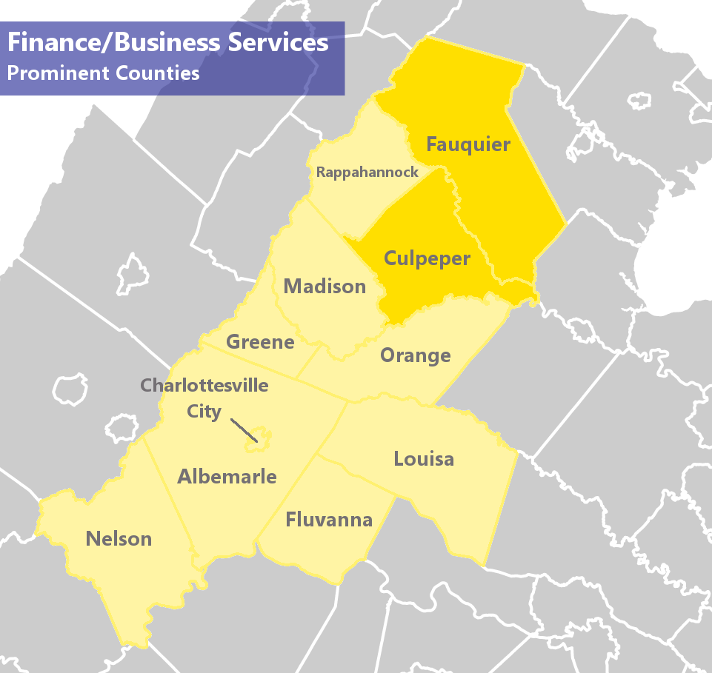
Notes:
There are a ton of people with lots of talent leaving each morning to work elsewhere mostly into northern VA
Northern portion of region 9 is cost competitive relative to other more expensive NOVA.
Not been in the competition because Fauquier doesn’t have the sites or broadband yet to compete
EXAMPLES OF SUBSECTORS IN THIS INDUSTRY: Management, Scientific, and Technical Consulting Services, Legal Services, Accounting, Tax Preparation, Bookkeeping, and Payroll Services, Architectural, Engineering, and Related Services, Activities Related to Real Estate, Agencies, Brokerages, and Other Insurance Related Activities, Financial Investment Activities, Insurance Carriers, Advertising, Public Relations, and Related Services, Printing and Related Support Activities, Specialized Design Services,

Slide 12
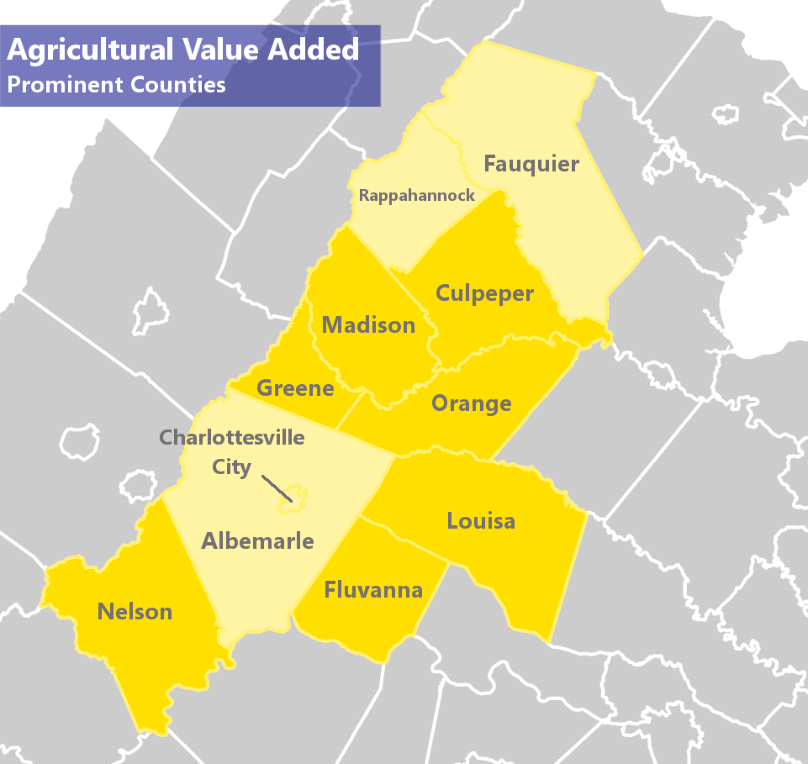
Notes:
National growth in craft beverages
Region has already experienced growth in craft brewing, historically it has been strong in the winery business as well.
Access to NOVA markets
Fits well with agricultural base of the region.
Obstacle – getting water/sewer to available sites.

Slide 13
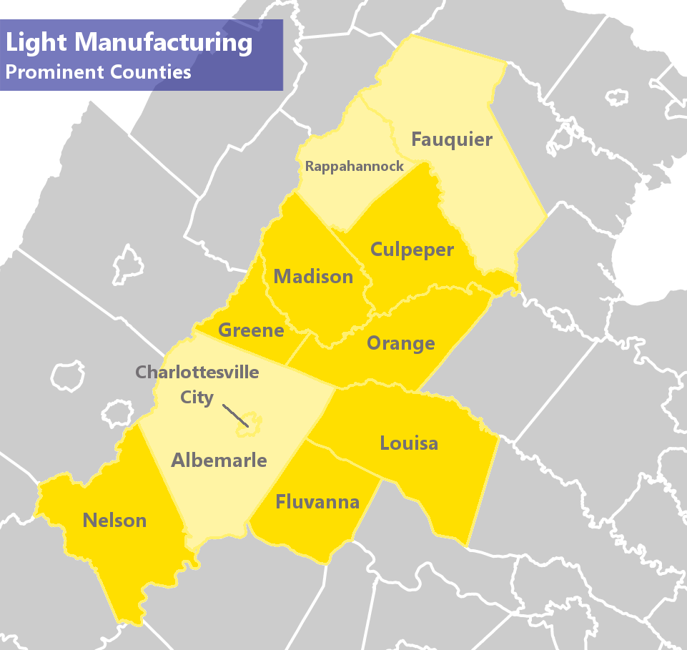
Notes:
This, like Food & Beverage manufacturing, is important to diversifying your ever increasing homogenous economy
These jobs can be higher paying within these counties,
Would want to focus on advanced manufacturing in particular for higher wage jobs
You may also have a little Transportation & Warehousing as a target in a County such as Louisa where there is access to Richmond market and highway?
EXAMPLES OF SUBSECTORS IN THIS INDUSTRY: Plastics Product Manufacturing, Navigational, Measuring, Electromedical, and Control Instruments Manufacturing, Sawmills and Wood Preservation, Other Wood Product Manufacturing, Household and Institutional Furniture and Kitchen Cabinet Manufacturing, Aerospace Product and Parts Manufacturing, Printing and Related Support Activities, Semiconductor and Other Electronic Component Manufacturing, Ventilation, Heating, Air-Conditioning, and Commercial Refrigeration Equipment Manufacturing, Medical Equipment and Supplies Manufacturing

Slide 14



Talent Development
Notes:
WHY DOES THIS MATTER – #1 business concern.
Our experience across the country – workforce has surpassed all other factors for economic growth
Super tight labor situation, need to focus on middle skills and upskilling current workforce, pulling up those underemployed or without credentials.

Slide 15
Business Workforce Survey Findings
Accommodation and Hospitality (11)
Administrative and Support and Waste Management (1)
Agriculture, Forestry, Fishing, and Hunting (12)
Arts, Entertainment, and Recreation (10)
Construction (9)
Educational Services (8)
Finance and Insurance (10)
Government (9)
Health Care and Social Assistance (11)
Information Technology (4)
Manufacturing (7)
Non-Profit (4)
Professional, Scientific, and Technical Services (21)
Public Administration (1)
Real Estate and Rental and Leasing (6)
Restaurant, Food Service (1)
Transportation and Warehousing (5)
Utilities (1)
Wholesale or Retail Trade (9)
Notes:
Simply to show that there were responses across many industries

Slide 16
Business Workforce Survey Findings
Notes:
Top Overall Challenges to Growth:
Workforce, workforce and workforce
Regulation
Top Workforce Challenges:
Finding a qualified workforce
Meeting compensation needs
Soft skills
Retain employees

Slide 17
Business Workforce Survey Findings
Notes:
Difficult:
Decision making
Problem solving
Critical thinking
****May be reporting these as more difficult because you have a heavily weighted knowledge economy type businesses
****For the same reason the following may be reported as easier skills to find
Easy:
Drug free
Customer focused
Team work
Respect
Integrity

Slide 18
Business Workforce Survey Findings
Notes:
Can’t fill a technical position in less than a month, yet all others you can.
Taking a longer time to fill open entry level positions

Slide 19
Opportunity #1
Talent Development
Develop Career Exploration and Awareness
Notes:
The region should promote in-demand career opportunities to high school students and showcase quality industry opportunities that are available to those who want to enter the workforce, pursue technical training, or proceed to a four-year institution.
Recognize that this is already a priority for the WIB, more a matter of continuing to push this in a coordinated fashion.
Nationally, an issue, as more and more kids being pushed automatically into a 4 year program, whether or not it is appropriate.
Either way, knowing the end game is important for kids.
Need more work-based learning and mentorship opportunities.

Slide 20
Opportunity #2
Talent Development
Strengthen Communication within the Talent Development System
Notes:
Led by the Piedmont Workforce Network, the region should reinforce partnerships throughout the talent development ecosystem to drive collaboration and become a more strategic workforce development system.
While the system needs to be driven by the demands of business, coordination among the entire talent development system, including workforce development, economic development and education partners is essential. WIB should be at the center.

Slide 21
Opportunity #3
Talent Development
Develop Sustainable Sector-Based Strategies to Implement Talent Solutions
Notes:
The region should facilitate the creation of sector-specific workforce strategies to address talent demands through coordinated, collective solutions.
Targeted Sectors:
IT/Communications
Bio-medical & Life Sciences
Finance & Business Services
Food & Beverage Manufacturing
Light Manufacturing
Convene businesses within target industry, identify common needs, establish strategies that will help. Must be driven my private industry folks.

Slide 22
Opportunity #4
Talent Development
Develop and Promote Career Pathways
Notes:
The region should help workers advance in their careers by promoting “Career Pathways” through the existing workforce development system.
My Career Path as an example:
Business education
Wall Street – trading room
Planning department intern
Masters degree in planning
Economic development
Food Processing Career Ladder:
Certificate
2 year degree at community college
4 year degree at Cornell
Region already doing this (at least nominally), needs to deepen and broaden.

Slide 23

Growing Existing Businesses
Notes:
WHY DOES THIS MATTER
All of the initiatives serve existing businesses (e.g. workforce development stuff help existing businesses). But, here are a few very specific things in addition to the general ones we see as important.

Slide 24

Opportunity #1
Growing Existing Businesses
Establish Broadband Partnerships
Notes:
Communities within Region 9 should help to greatly extend quality broadband to their citizens and businesses by entering into public-private partnerships to solve certain infrastructure shortcomings.
Very rural region with some underserved areas
My business could not exist in an area now that does not have reliable broadband service
Orange county model is very interesting – they are building out fiber to communication towers for public purposes, will be spec-ing out the system to accommodate private use for wireless internet.
Bottom line – broadband is what electricity was 100 years ago, the push for basic service to all.

Slide 25
Opportunity #2
Growing Existing Businesses
Concentrate on Innovation Corridor Branding
Notes:
The Innovation Corridor Branding initiative should raise the profile of the region to be a nationally-recognized “brand” for innovation, particularly within the biotech, defense, cybersecurity and financial services fields.
Research Triangle, Route 128 Corridor in Boston, Silicon Valley… need an instantly recognizable name that people use. Success breeds success, but only if people know and understand.

Slide 26
Opportunity #3
Growing Existing Businesses
Harness Regional Assets to Develop and Promote Biotech Hub
Notes:
The Biotech Hub should create a large amount of new square footage in a concentrated geographic area geared towards the biomedical and biotechnology industries to attain a critical mass of businesses, talent and intellectual property, thus making the region a leading national biotech center.
Currently have 400,000 sf, likely need to double that, no where to put them. All want to be in Charlottesville. $350mm of researching going on there, tons of talent, tons of synergies. Don’t let this pass you by.

Slide 27

Startups/Innovation/Commercialization
Notes:
WHY SHOULD YOU CARE?
These are potentially the super high paying jobs with lots of spinoff activity. Keep your students and jobs here.
Notes from Cathy:
We found a large population of innovative, creative and entrepreneurial individuals in the region.
Compared to 5 and 10 years ago, a lot of progress, but it’s geographically concentrated in far north and south
Programs are skewed towards student-led and early stage entrepreneurs, but thinner at post-idea stage.
Although folks all say they work together, there is competition for scarce resources for some types of offerings (e.g. the three new incubator projects all planned for C-ville) and no offerings elsewhere (e.g. Culpeper).
Overall Objectives should be:
-Take ecosystem to the next level in breadth and depth of assistance
-Provide increased access to capital
-All should support fast growing companies that can become substantial employers: tech, bio AND other.

Slide 28
Opportunity #1
Innovation
Grow the Entrepreneurial Ecosystem
Notes:
Region 9 should support the development and operations of strong entrepreneurial assistance programs throughout the region.
Aim to eliminate duplication and increase collaboration, while consolidating operations to obtain critical mass.
Need not just office space, you need to provide a comprehensive suite of services to entrepreneurs. Region has a number of assets, but thin and fragmented.
Start one in Culpeper to fill a hole, otherwise, consolidate and offer better and more services, specialized help.
Cathy’s notes:
Would provide grants, technical assistance — objective - get folks to work together
Defined co-working, incubator, accelerator
Everyone should be within 45minutes of some facility or program
Relatively easy to gain $ for buildings, but hard to get operational monies. Entrepreneurship is a public good, could invest there.
If all work together, can stop duplication, share resources, have more specialized expertise (e.g. bio, food-based, etc.)
Objective should be inclusive so all residents are empowered by access to opportunities to create their own employment.

Slide 29
Opportunity #2
Innovation
Provide Tax Incentive For Investments in Local Startups
Notes:
Region 9 should increase the capital available for locally-grown businesses by providing a local tax incentive that builds on the Commonwealth's investment tax credit.
Lobby for increase in the $5mm cap.
Locally, Region could fund a 50% booster to the credit. Example being Montgomery County MD which match’s Maryland’s Biotechnology Investment Tax Credit program credits.
Cathy’s notes:
Objective, increased capital availability
In 2014, 254 investors claimed the existing tax credit on their VA returns. Some smaller portion of these folks invested in R9 companies (not known how many), but trying to get an idea how much this would cost.
Like Montgomery County, MD, a grant to match state tax credit.
Know that these types of tax credits expand local investment, bring in outside $ and new $ (e.g., Minnesota Study)

Slide 30
Opportunity #3
Innovation
Provide Additional Capital for Expansion
Notes:
The Additional Capital for Expansion program should help high-growth companies in Region 9 accelerate and stay in the region.
Seed and venture is okay, but Series A, B and C is more difficult.
Consider a hybrid fund – public money thrown in with private equity money that runs the fund. Examples: Michigan Accelerator Fund and the Ohio Rev 1 Fund.
Cathy’s Notes:
Objective: provide capital for fast growing young businesses
Known that companies are leaving area b/c latter stage investors from away are requiring relocation.
Either attract VCs to open offices here (they tend to invest locally) AND/OR
Develop a hybrid fund where state and private dollars are invested alongside, with same goal - financial returns. [Note I gave Jim Cheng the paper on this at his request.]

Slide 31

Sites
Notes:
WHY SHOULD YOU CARE
This was clearly one of the biggest issues (#2 only to workforce) the Region faces. You simply have little or no “product” to offer. Companies are leaving. No way to attract new companies.

Slide 32
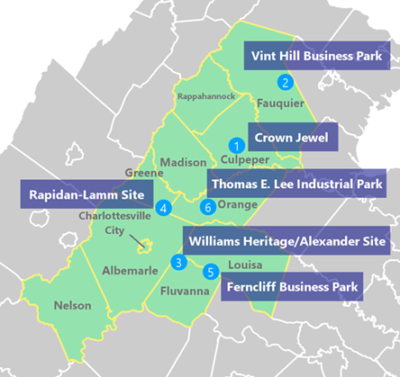
Sites Evaluated
Culpeper County: Crown Jewel Site
Fauquier County: Vint Hill Business Park
Fluvanna County: Williams Heritage / Alexander Site
Greene County: Rapidan Center
Louisa County: Ferncliff Business Park
Orange County: Thomas E. Lee Industrial Park
Notes:
Sites in 6 of the 10 counties

Slide 33
Targeted Industry Fit by Site
Industry Sector | McDevitt/ Culpeper* | Vint Hill/ Fauquier* | Williams Alexander/ Fluvanna | Rapidan/ Greene | Ferncliff/ Louisa(TC) | TE Lee/ Orange
IT/ Communications | Good | Good | Poor | Marginal | Poor | Poor
Biomedical/ Biotechnology | Poor | Marginal | Poor | Marginal | Poor | Poor
Finance/ Business Services | Poor | Good | Poor | Good | Poor | Poor
Food and Beverage Manufacturing | Marginal | Poor | Marginal | Poor | Good | Marginal
Light Manufacturing | Good | Marginal | Marginal | Poor | Good | Good
Notes:
No place to put biomedical/biotechnology
Very limited sites for the other industries
Clearly a limiting factor for the Region
Good news – some needs are low cost to address – Phase I ESAs, wetlands delineation, geotechnical.
Bad news – many sites will require a large infrastructure investment.

Slide 34
Target Industry Conclusions – Sites
Two sites were a marginal fit for companies in the Biomedical/Biotechnology field.
Three sites were a good fit for Light Manufacturing operations, but 2 of 3 do not have natural gas service.

Slide 35
Target Industry Conclusions – Sites
Best fit for Food and Beverage Manufacturing is Ferncliff in Louisa County.
Site in Fluvanna County is lacking proper due diligence and necessary utilities to be competitive for projects.
All sites could benefit from updated due diligence studies.

Slide 36
Site Improvement Action Items
Conclusions
Recommended Site Improvement Action Items
Site | Recommended Improvements
Culpeper County | Rezoning, Phase I, Wetlands Delineation, Preliminary Geotechnical Study, Option Sites
Fauquier County | Wetlands Delineation, Preliminary Geotechnical Study
Fluvanna County | Engineering Studies, Phase I, Tree Clearing, Wetlands Delineation, Preliminary Geotechnical Study
Greene County | Phase I, Wetlands Delineation
Louisa County | Natural Gas Due Diligence Study, Transportation Infrastructure (as needed)
Orange County | Option Lot 10, Phase I on Lot 10, Engineering Study for Gas (or extend infrastructure)
Notes:
These are the recommended improvements to be made, possibly through GOVA. (covered in later slides)

Slide 37
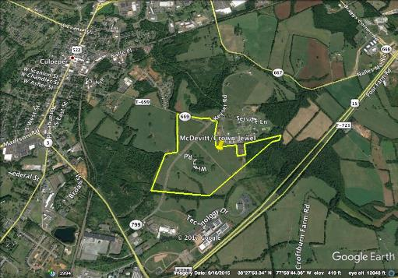
Site Profile
Culpeper County
McDevitt/Crown Jewel
Target Industry Recommendations
Industry Sector | Industry Fit
IT/ Communications | Good
Biomedical/ Biotechnology | Poor
Finance/ Business Services | Poor
Food and Beverage Manufacturing | Marginal
Light Manufacturing | Good
Site Improvement Action Items
Task Item | Priority
Rezoning | High
Phase I | High
Wetlands Delineation | Moderate
Preliminary Geotechnical Study | Moderate
Option Sites | Moderate
Best data center site.
Abundance of water makes good for water intensive projects.
Notes:
You will have to fly through these slides, so I don’t need to do notes. Just focus on the site improvement action items.

Slide 38
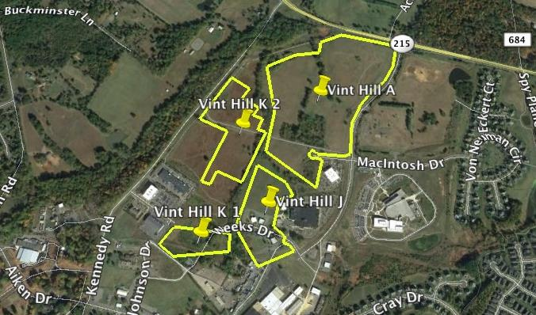
Site Profile
Fauquier County
Vint Hill
Target Industry Recommendations
Industry Sector | Industry Fit
IT/ Communications | Good
Biomedical/ Biotechnology | Marginal
Finance/ Business Services | Good
Food and Beverage Manufacturing | Poor
Light Manufacturing | Marginal
Site Improvement Action Items
Task Item | Priority
Preliminary Geotechnical Study | Moderate
Wetlands Delineation | Moderate
Experiencing growth from DC market
All utilities in park.
Resistance to development that would be heavier in nature.
Notes:
You will have to fly through these slides, so I don’t need to do notes. Just focus on the site improvement action items.

Slide 39
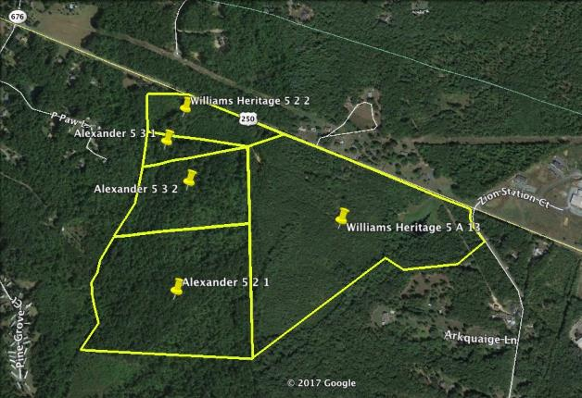
Site Profile
Fluvanna County
Williams Heritage/Alexander
Target Industry Recommendations
Industry Sector | Industry Fit
IT/ Communications | Poor
Biomedical/ Biotechnology | Poor
Finance/ Business Services | Poor
Food and Beverage Manufacturing | Marginal
Light Manufacturing | Marginal
Site Improvement Action Items
Task Item | Priority
Tree Clearing | Moderate
Phase I | Moderate
Wetlands Delineation | Moderate
Engineering Studies | High
Preliminary Geotechnical Study | Low
Good interstate access.
Lacks utilities (gas, water, wastewater).
Site has not been characterized.
Notes:
You will have to fly through these slides, so I don’t need to do notes. Just focus on the site improvement action items.

Slide 40
Site Profile
Greene County
Rapidan Center
Target Industry Recommendations
Industry Sector | Industry Fit
IT/ Communications | Marginal
Biomedical/ Biotechnology | Marginal
Finance/ Business Services | Good
Food and Beverage Manufacturing | Poor
Light Manufacturing | Poor
Site Improvement Action Items
Task Item | Priority
Phase I | High
Wetlands Delineation | Moderate
Good fit for business park or retail as originally planned.
Residential nearby.
Notes:
You will have to fly through these slides, so I don’t need to do notes. Just focus on the site improvement action items.

Slide 41
Site Profile
Louisa County
Ferncliff Industrial Park
Target Industry Recommendations
Industry Sector | Industry Fit
IT/ Communications | Poor
Biomedical/ Biotechnology | Poor
Finance/ Business Services | Poor
Food and Beverage Manufacturing | Good
Light Manufacturing | Good
Site Improvement Action Items
Task Item | Priority
Transportation Needs | Moderate
Natural Gas Due Diligence | Moderate
Established industrial park with 2 speculative buildings.
All utilities except natural gas.
Good access to interstate.
Expansion area recently acquired.
Notes:
You will have to fly through these slides, so I don’t need to do notes. Just focus on the site improvement action items.

Slide 42
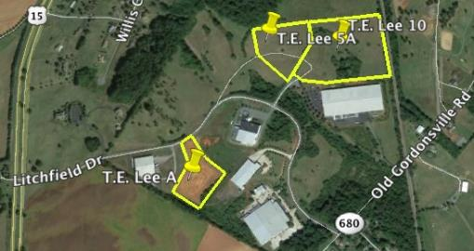
Site Profile
Orange County
Thomas E. Lee
Target Industry Recommendations
Industry Sector | Industry Fit
IT/ Communications | Poor
Biomedical/ Biotechnology | Poor
Finance/ Business Services | Poor
Food and Beverage Manufacturing | Moderate
Light Manufacturing | Good
Site Improvement Action Items
Task Item | Priority
Option Lot 10 | Moderate
Engineering Study for Natural Gas | Moderate
Phase I on Lot 10 | Low
Established park with light manufacturing operations. Remote area of the region.
Rail adjacent but grade change concerns.
Notes:
You will have to fly through these slides, so I don’t need to do notes. Just focus on the site improvement action items.

Slide 43
Other
Sites
Better Leverage UVA’s Research Park
Notes:
This initiative would position the UVA Research Park to be the premier office and research park in the region.
Master plan just completed, they appear to be opening up to other uses
Our initial outreach to them indicated that they would be willing to consider non-UVA-users.
This is the top park in the Region for readiness.
We did not profile it because, until August, it was not even clear if UVA would accept anything but a college-use there.

Slide 44
Other
Sites
Create and Promote Other Sites
Notes:
Region 9 should encourage additional site development activities beyond the six aforementioned sites and the UVA Research Park.
Why – B/C site development takes many years, need to get “product” into the “pipeline”.

Slide 45
Other Opportunities
Notes:
Explain why these are important:
Need direction, leadership and funding

Slide 46
Opportunity #1
Other Opportunities
Realign Organizational Focus within the Central Virginia Partnership
Notes:
Recession and shift in local economies has forced regional EDOs to rethink what they do.
Once marketing and attraction, now WF, access to capital, BR&E, site development, quality of life initiatives….
The Central Virginia Partnership leadership needs to shift resources to
provide additional site readiness support to municipal EDOs within the region
facilitate greater coordination between regional stakeholders and the University of Virginia
UVA is the economic development driver for the region.
Start ups
Medical
R&D
Research park

Slide 47
Opportunity #2
Other Opportunities
Pursue Organizational Funding & Capacity Building Mechanisms for Plan Implementation
Notes:
National trend for regional EDOs is greater private funding support and the raising of funds through organized funding campaigns
This is a very unique region with a unique set of challenges (attitudes toward more development, ability of existing businesses to find space) and opportunities (innovation, commercialization of R&D and new business start-ups)
Develop a sustainable funding mechanism that will give Region 9’s support organization the financial resources needed to address these emerging challenges and opportunities and allow for Plan execution.
Will also provide funding to leverage GOVA investment that will be required

Slide 48

Questions

Slide 49
Project Application Process
Notes:
Helen Slide

