Slide 1
“Venture Hub” Business Plan
October 10, 2019

Slide 2
Agenda
Introduction
Opportunity
Concept
How It Will Work
Governance
Financials
Next Steps
Photo by Danielle MacInnes on Unsplash

Slide 3
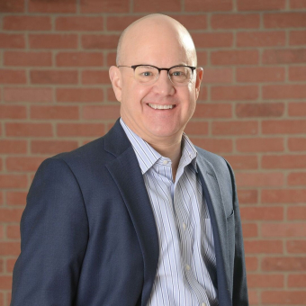
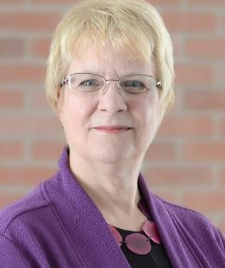
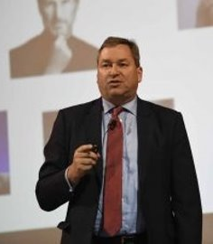
Key project team members
Dan Gundersen
Senior Vice President
Catherine Renault
Senior Advisor
Erik Pages
Project Manager

Slide 4
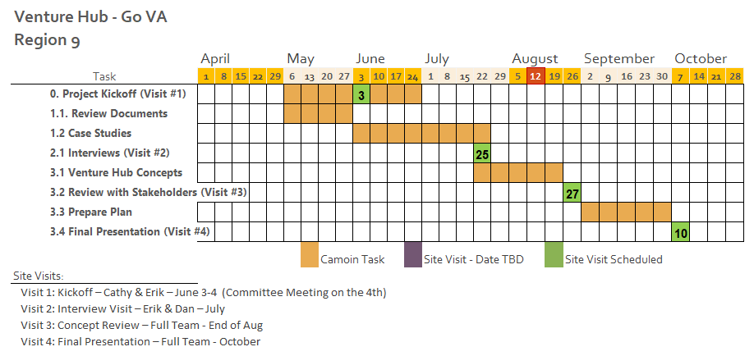
Project status
We are here

Slide 5
“Venture Hub” opportunity
Region 9 is richly endowed with great entrepreneurs, investors and world-class researchers. The region performs well, but could do better. The “Venture Hub” is designed to enable local people to start and grow new businesses that support economic prosperity by:
Serving as a gateway to help connect people with existing entrepreneurship resources and encourage the creation of resources as the need arises
Accelerating new business growth, and
Telling the story of the region as a center for entrepreneurship

Slide 6
Lessons learned
Entrepreneurial leadership
Diverse and comprehensive programming, but
Build on anchors
Partner, collaborate, extend, do not duplicate
Diverse funding sources useful for sustainability
Nonprofit most common form with broad board membership

Slide 7
“Venture Hub” concept
The “Venture Hub”* will be a place that focuses the entrepreneurial energy in GO Virginia’s Region 9, enabling entrepreneurs to accelerate their contribution to inclusive economic prosperity.
The “Hub” will leverage and amplify the existing resources in the entrepreneurial ecosystem.
Ultimately, the “Hub” will be a symbol of the region’s entrepreneurial energy.
*“Venture Hub” is a placeholder name. A branding exercise will be used to create a memorable and place-connected name that conveys the full concept.
Photo by Andrew Neel on Unsplash

Slide 8
“Venture Hub” principles
The “Hub” is designed for entrepreneurial support, and entrepreneurs are its primary customers
The “Hub” will partner and collaborate with organizational anchors and elements of the entrepreneurial ecosystem in Region 9
The “Hub” will embrace the diversity of Region 9, defined in geographic as well as demographic terms
Programming will be focused to support the unique challenges of different segments of the target audience
Photo by Josh Calabrese on Unsplash

Slide 9
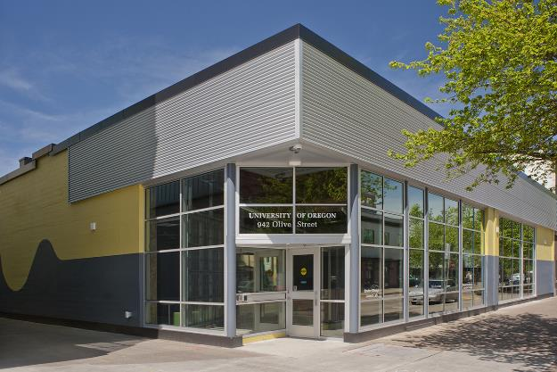
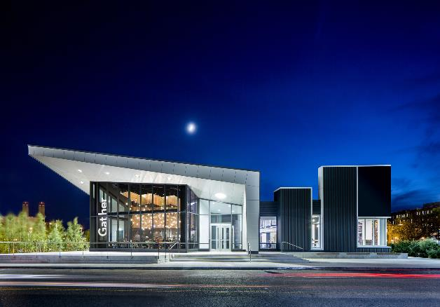
A Place to Meet
Housed in an iconic building designed to facilitate connections and collaborations
Host programming and events big and small, most currently offered by partners at disparate locations
May also be home to partners who wish to co-locate, and may feature a café or other places for informal meetings, reflection, or refreshment
Centrally located in Charlottesville/Albemarle County
Smaller “Hub” type facilities may also be hosted or co-located with entrepreneurial resources in other parts of the Region, and networked together through the “Hub’s” essential services
Oregon RAIN building in Eugene, OR
District Hall in Boston’s Seaport Innovation District
Notes:
The “Venture Hub” will be a place where entrepreneurs and other members of the ecosystem can convene, network, learn, create and celebrate.

Slide 10
A Place to Connect
The Concierge Service will serve entrepreneurs
Assess their situation
Identify next steps on their entrepreneurial journey
Refer to appropriate resources in the region and beyond
Partner network
Photo by John Barkiple on Unsplash

Slide 11
A Place to Tell Stories
Highlight the narrative of Region 9 as an entrepreneurial powerhouse
Shine a light on regional entrepreneurs, resources, and their interactions
Embody of the entrepreneurial dynamism in Region 9
Act as a focal point for citizens within the area as well as those outside the Region
Photo by Daniel Chen on Unsplash

Slide 12
A Place to Collaborate
Convene ongoing conversations about what is needed
Facilitate the definition, development, piloting and launch of new initiatives
New initiatives launched by partners or by “Hub”
Photo by Dil on Unsplash

Slide 13
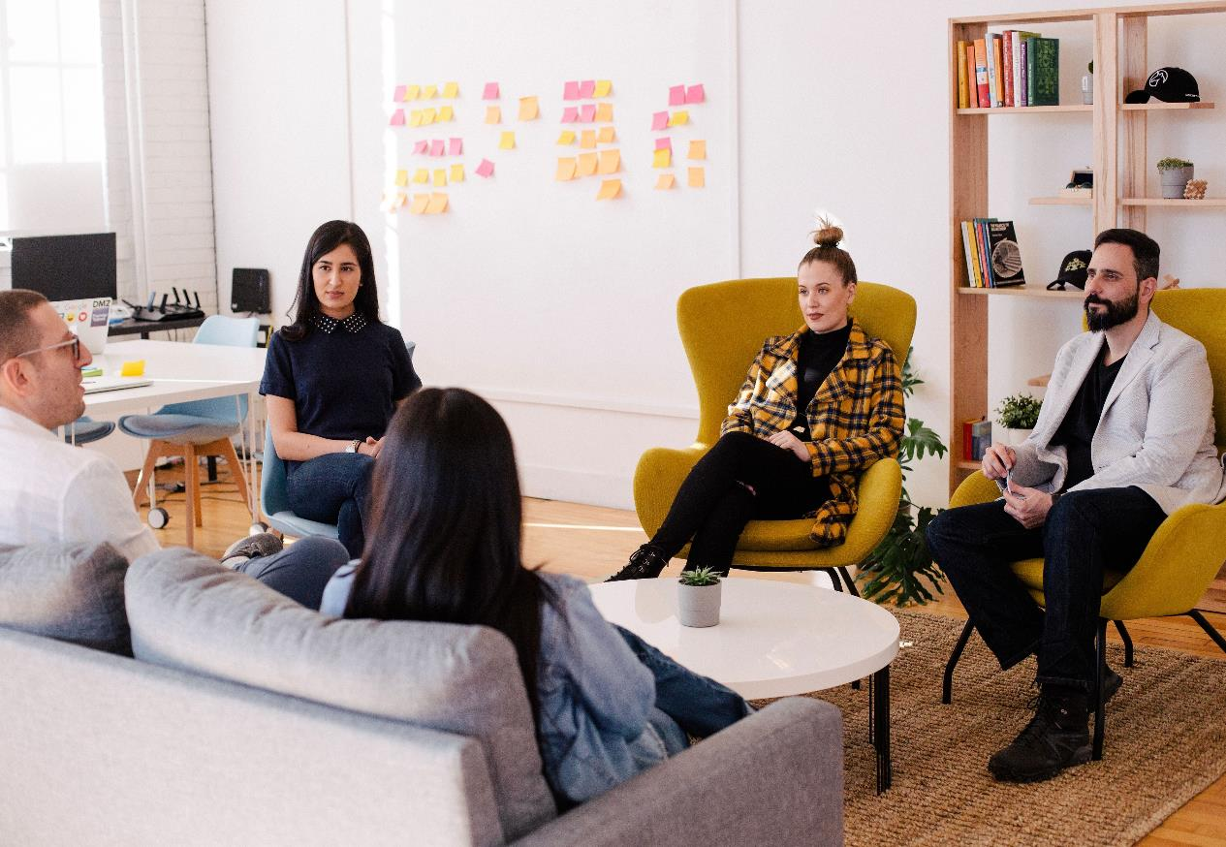
“Hub’s” governance
Non-profit 501(c)(3)
Private-sector led Board of Directors with 13 members
Three Advisory Committees
Entrepreneurs
Partners, funders, and service providers
Economic development officials
Three employees
Executive Director
Concierge
Events/Facility/Marketing Coordinator
Photo by You X Ventures on Unsplash

Slide 14
Financial highlights At full implementation:
Annual operating costs exceed $750,000 if market rates for rent and salaries are assumed
Location, size, make or buy, extent of renovations required, all impact cost of place
Earned revenues (subleasing offices, event space)
Support from state, local governments, corporations, university, philanthropy start at $350,000 annually
Photo by Emily Jackson on Unsplash

Slide 15
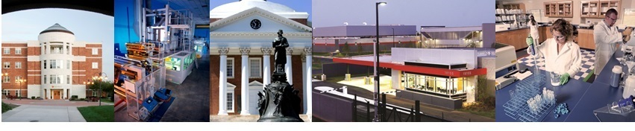
The “Venture Hub” will increase the density of the entrepreneurial ecosystem in the region, including access to entrepreneurial assistance
Entrepreneurs will do better
They will increase their 5-year survivability
Job growth will increase
Rising inclusive economic growth for the region
This Photo by Unknown Author is licensed under CC BY-SA

Slide 16
More to Come
"Friends of Venture Central"
Chris Engel Denise Herndon Roger Johnson Pace Lochte

Slide 17
Questions and Discussion
Dan Gundersen, FM, HLM
dan@camoinassociates.com
Catherine Renault
Erik Pages
crenault@innovationpolicyworks.com
epages@entreworks.net

