Slide 1

Region 9: Piedmont Opportunity Corridor
Update on Entrepreneurial Trends
October 1, 2021

Slide 2
Updated 2021 Analysis of Entrepreneurial Trends
Phase One: Analysis of Startup Activity and Firm Dynamics
Phase Two: Analysis of Broader Innovation Ecosystem Measures
The Quarterly Workforce Indicators (QWI) from U.S. Census is a longitudinal database with detailed data related to the job creation and other characteristics of firms, including by age groupings.
  Most Detailed Level of Geographic Coverage: County
  Coverage: Covers over 95% of U.S. private sector jobs (does not cover ag jobs, self-employment)
  Grouping of Employment by Age of Firms: 0-1 Years; 2-3 Years; 4-5 Years; 6-10 Years; 11+ Years
  Industry Coverage: 2-digit industry, which can define at a high-level traded industries
  But QWI does not track or provide information on individual firms – so not tracking growth of firms over time
  All data is on a quarterly basis
The Business Dynamics Research Consortium (BDRC) database is a time-series dataset that catalogues individual establishments by location, employment, sales, and industry from 1997 to 2017. The BDRC It is maintained by the University of Wisconsin
  Coverage: It compiles multiple data sets to track performance and growth for more than 144 million individual businesses across the United States.
  Provides extensive firm level data
  Able to identify firm by address
  Detailed industry coverage
Academic R&D – annual research expenditures from all sources by university reported by the National Science Foundation’s Higher Education Research and Development Survey
Patent Activity of Inventors Residing in Region – annual patents generated by residents in the region from U.S. Patent & Trademark Office data collected by Derwent Innovation
Venture Capital – PitchBook database of private investor funding in emerging ventures, including pre-seed (accelerator and incubator funding), angel investor, seed and formal venture capital
Federal Small Business Innovation Research (SBIR) Awards – SBIR funding by federal agencies to small businesses in the region as reported from SBIR.gov maintained by the U.S. Small Business Administration
SBA 7(a) Loan Activity – Number of loans and loan amounts to small businesses in traded sector industries under SBA 7(a) financing vehicles as reported by the Small Business Administration

Slide 3
Key Findings
Phase One: Analysis of Startup Activity and Firm Dynamics
Phase Two: Analysis of Broader Innovation Ecosystem Measures
Higher share of Region 9 traded sector employment found in startups and younger firms than for the state or nation on an annual basis since 2010
  17.5% Region 9; 12.8% VA; 14.1% for U.S.
Startup (0-5 years) net employment growth in Region 9 stands out on an annual basis over 2010-2020:
  On a year-by-year basis has led Region 9’s growth in overall traded sector net employment gains
  Startup annual employment gains in Region 9 represent higher share of total traded sector jobs than for the State or Nation
  Though Region 9 also has had the largest share of annual decline in older firms relative to total traded sector jobs compared to State and Nation
Region 9’s business formation rates slightly above state average, consistently over the years
Pick up in startup activity in 2020
While Charlottesville is hotbed of startup activity, there are pockets found across the region
Mixed performance across traded sector clusters for Region 9:
  Business services has highest # of startups in Region, but lags statewide business formation rate
  Ag & Food Processing (second highest # of startups) and Engineering/R&D/Testing clusters led statewide business formation rate
  Information Technology and Financial Services picked up in startup activity from 2019 to 2020
Strong growth in academic research – still primarily focused on biohealth
Patent activity generally steady –shows broader strengths of region in IT-related technologies along with biomedical
Venture capital significant ramp-up over 2017-2020 period, with 2020 recording a new high
  Broad mix of deal activity across investment stages over 2010-2020 period
SBIR awards falling off pace of 2010-2015
Utilization of SBA 7 (a) business loans by traded sector companies behind state and national averages

Slide 4
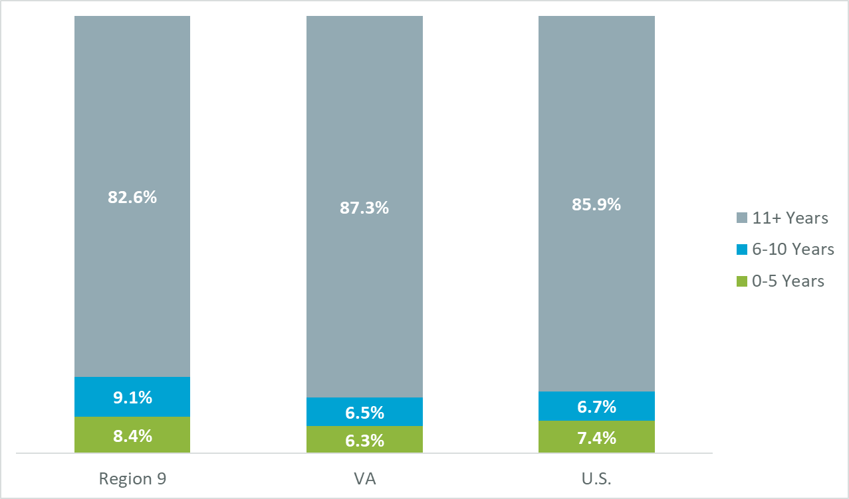
Regional Employment Distribution by Age of Firm for Traded Industries
What is it? A more “static” look at where current traded industry jobs are found by different firm ages across all traded industries
Why it matters? Makes the point that job retention activities with existing firms are an important component of a region’s economic development strategy
Traded Industry Employment Levels by Firm Age as a Percentage of Total Traded Sector Jobs, Averaged 2010 Q1 through 2020 Q2
Source: U.S. Census Bureau Quarterly Workforce Indicators dataset.

Slide 5
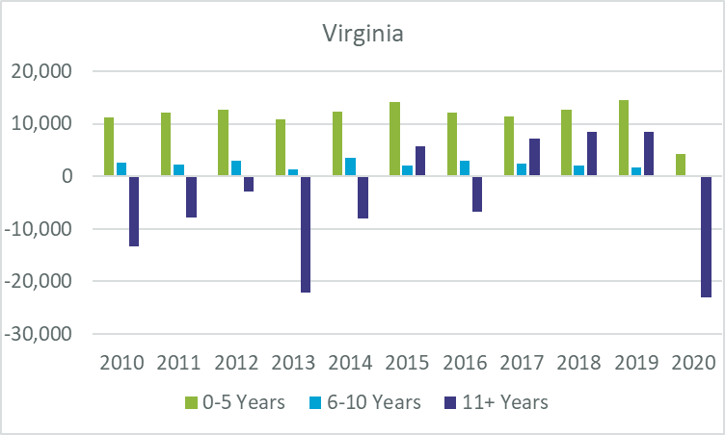
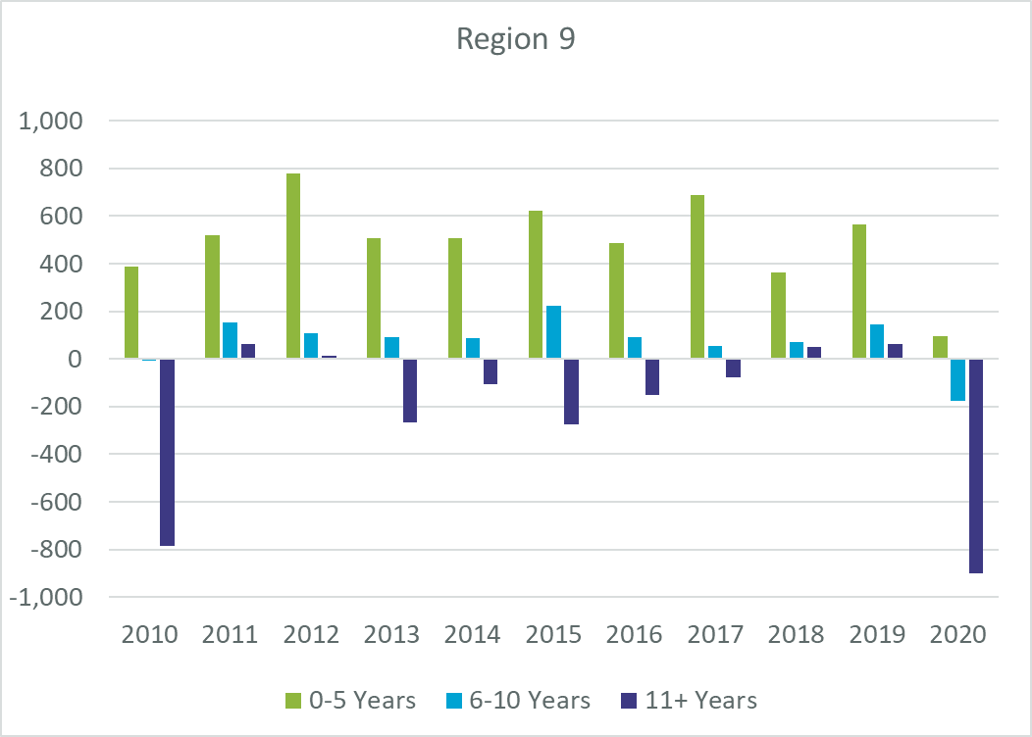
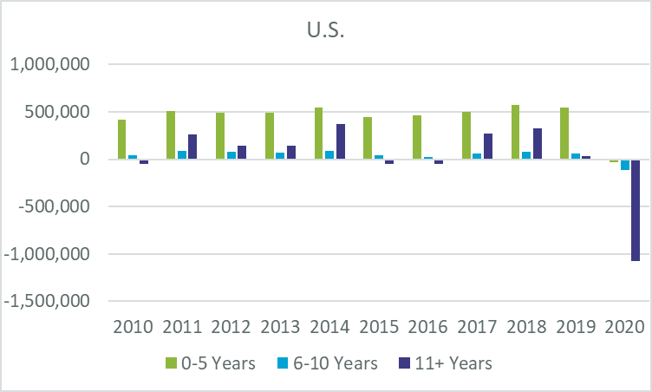
Year-to-Year Job Change in Traded Industry Base by Age of Firm
What is it? A more “dynamic” look at job changes by age of firm on a year-to-year basis in your region’s traded industry base
Why it matters? Reveals that the presence of new and younger firms in any year are a critical driver of job growth in a region -- even’ as the previous slide shows’ that they do not employ most workers in traded industries
Traded Industry Job Change by Firm Age, 2010 Q1 through 2020 Q2
Source: U.S. Census Bureau Quarterly Workforce Indicators dataset.

Slide 6
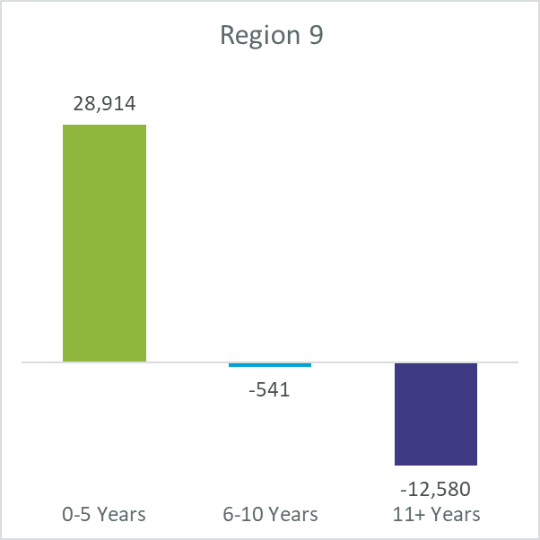
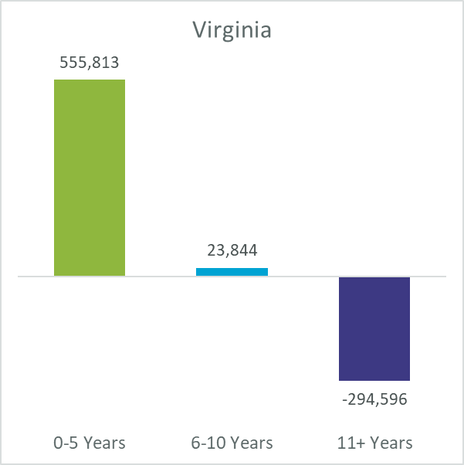
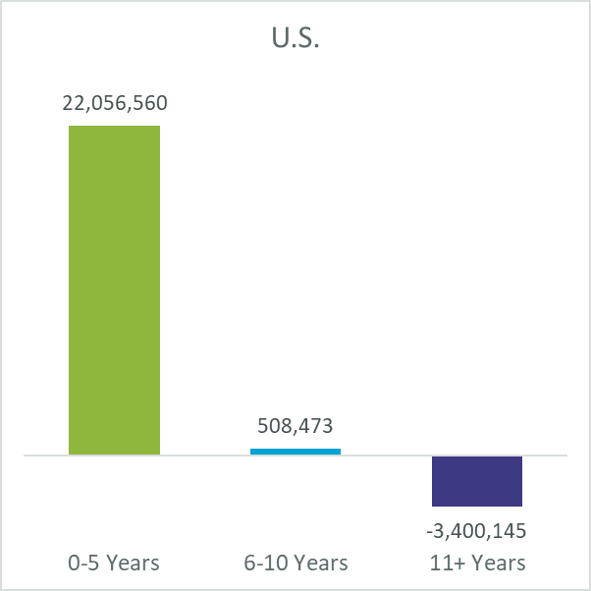
Employment Growth by Age of Firm Annually over 2010-2020 Period
What is it? Aggregates quarterly employment change from 2010/Q1 through 2020/Q2 for traded industries by age
Why it matters? Offers a more consolidated view over a long period of time on sources of job growth by age of firm annually – confirming the importance of new and younger firms for job growth at the region, state and national level
Traded Industry Job Change by Firm Age, Aggregated 2010 Q1 through 2020 Q2
Source: U.S. Census Bureau Quarterly Workforce Indicators dataset.

Slide 7
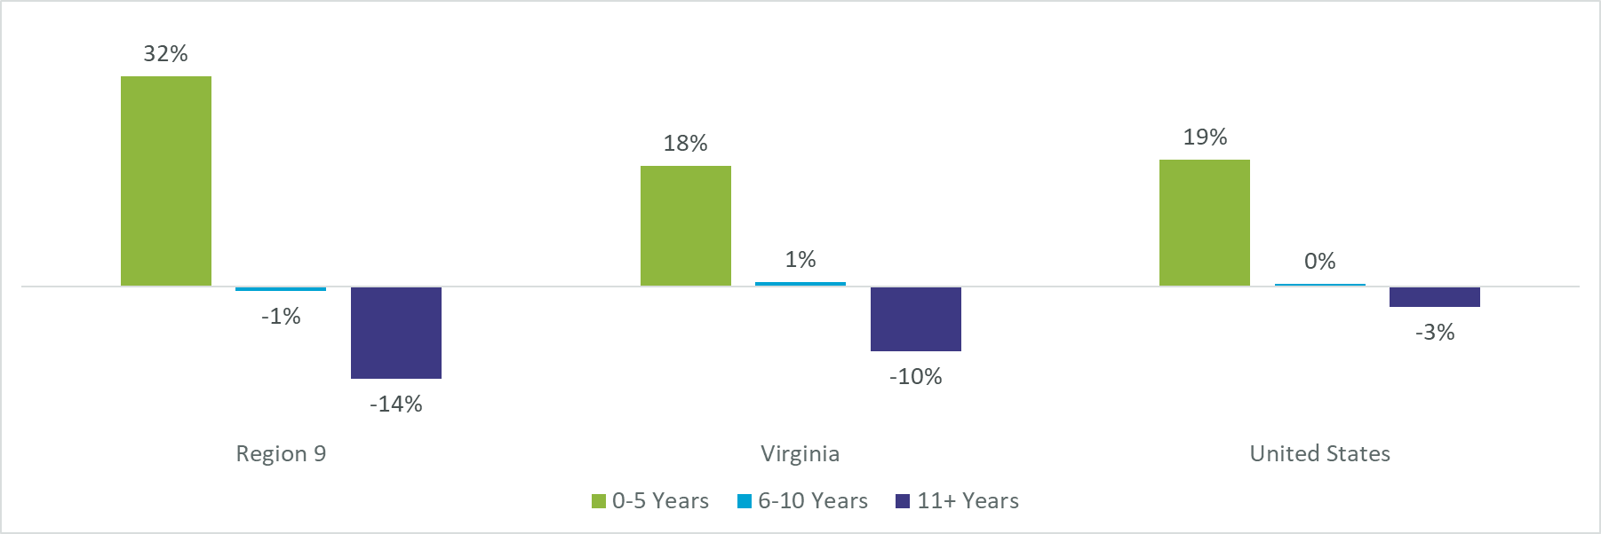
Share of Employment Growth by Age of Firm Annually over 2010-2020
What is it? Aggregates quarterly employment change from 2010/Q1 through 2020/Q2 for traded industries by age relative to total traded sector employment
Why it matters? Allows a comparison of Region to State and Nation to see contribution of different age of firms to employment growth on an annual basis over the 2010-2020 period
Net Job Change as a Percentage of Average Employment on an , 2010- 2020 Q2 by Firm Age
Source: U.S. Census Bureau Quarterly Workforce Indicators dataset.

Slide 8
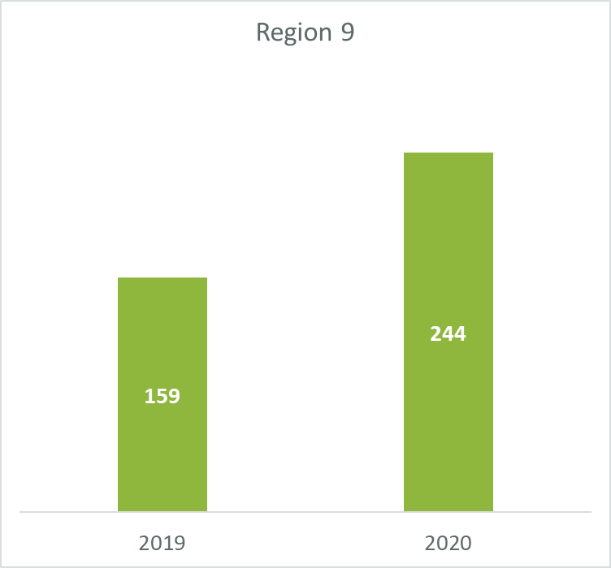
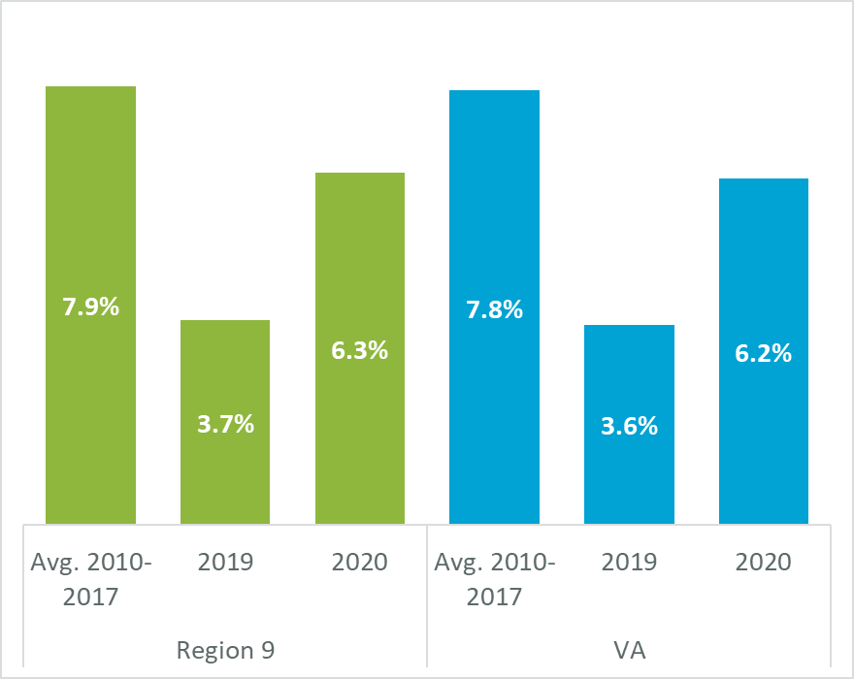
BDRC Profile of Startup Activity and Business Formation Rates in Traded Industries
What is it? Startups are all new non-branch firms in traded industries with their first recorded employment in a given year, while the Business Formation Rate compares the level of startups to the total number of all firms in traded industries.
Why it matters? Together, the total number of Traded Industry Startups and Business Formation Rates allows a region to determine whether its startup activity is rising or declining, with the Business Formation Rates offering a normalized measure for a region to compare itself to other jurisdictions as well as within industries.
New Startups* in Traded Industries, 2019 and 2020
New Business Formation Rate in Traded Industries, 2010-2020**
Note: 2018 excluded due to addition of a major source of firm data to underlying BDRC database that makes comparisons using 2018 not possible
Source: Business Dynamics Research Consortium, Your-economy Time Series (YTS); TEConomy analysis.

Slide 9
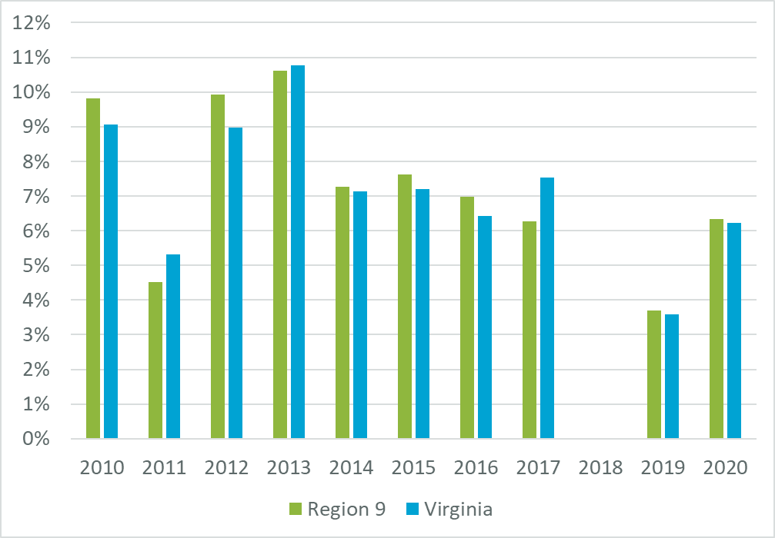
Year-by-Year New Business Formation Rates in Traded Industries
What is it? Annual Business Formation Rates compares the level of startups to the total number of all firms in traded industries for region compared to state.
Why it matters? Depicts the longer-term pattern of Business Formation Rates for the region in traded industries and how it has generally fallen over the past decade at both the region and state level.
New Business Formation Rate in Traded Industries, 2010-2020
Note: 2018 excluded due to addition of a major source of firm data to underlying BDRC database that makes comparisons using 2018 not possible
Source: Business Dynamics Research Consortium, Your-economy Time Series (YTS); TEConomy analysis.

Slide 10
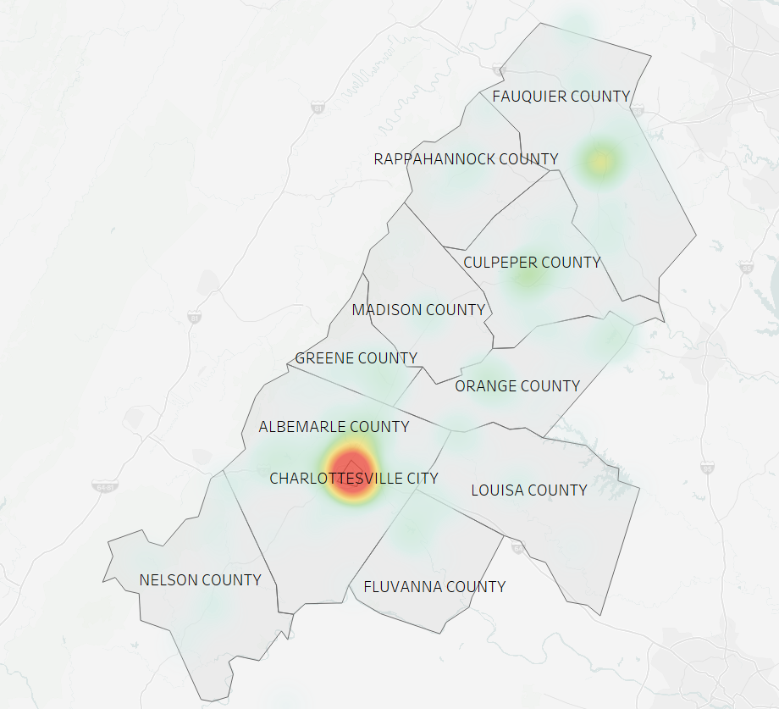
Startup Density* Across Region 9
What is it? A mapping of where traded industry startups are located within a region over the 2018-2020 period based the specific geo-coordinates of the firm’s address
Why it matters? Reveals the areas within a region where startup activity is aggregating that can help inform how to advance place-based developments, such as incubators, accelerators, and co-working spaces, and other entrepreneurial services
Significant Activity
Moderate Activity
Limited Activity
Note: This map is based on geocoordinates of individual establishments, not an aggregation of establishment counts to a prescribed geography such as census tracts. The mapping software plots a visualization of startup spread by analyzing the clustering of coordinates in a multi-dimensional spatial context relative to each region. It is not possible to provide a numeric estimate of density (i.e. establishments per square mile) since calculation of spread is multi-dimensional and not fixed to a prescribed geographic boundary.
*Startup density is relative to overall regional startup rates
Source: Business Dynamics Research Consortium, Your-economy Time Series (YTS); TEConomy analysis.

Slide 11
Profile of Startup Activity Within Key Regional Industry Clusters
What is it? Tracks number of Startups and Business Formation Rates across a standardized set of Traded Industry Clusters for the region and statewide average in 2019 and 2020. The standardized clusters were informed by priority clusters set out across all GO VA regions (see separate handout for NAICS industries included in each Traded Industry Cluster).
Why it matters? Allows a region to determine the trends and competitiveness of its startup activity across Traded Industry Clusters in the region with comparison to the statewide average business formation rate for each Traded Industry Cluster.
Major Traded Industry Cluster*** | Startups, 2019 | New Business Formation Rate, 2019 |  | Startups, 2020 | New Business Formation Rate, 2020
 |  | Region | State |  | Region | State
Agriculture & Food Processing | 23 | 5.8% | 4.1% | 25 | 6.8% | 5.5%
Business Services | 51 | 3.9% | 4.4% | 77 | 7.0% | 7.6%
Energy, Natural Resources, & Finished Products | 5 | 2.6% | 2.5% | 7 | 3.8% | 3.9%
Engineering, R&D, Testing & Technical Services | 10 | 7.4% | 4.2% | 9 | 7.6% | 7.4%
Financial & Insurance Services | 5 | 1.5% | 3.5% | 21 | 5.8% | 4.0%
Health Care Services | 4 | 7.8% | 4.2% | 6 | 12.5% | 15.8%
Information Technology & Communications Services | 6 | 3.2% | 3.6% | 18 | 10.6% | 8.0%
Life Sciences | 5 | 4.6% | 2.7% | 6 | 5.8% | 6.1%
Manufacturing | 8 | 3.3% | 2.1% | 5 | 2.4% | 3.7%
Ship Building, Aerospace, & Defense |  |  | 1.1% |  |  | 0.9%
Transportation, Distribution and Logistics | 12 | 2.6% | 2.9% | 16 | 4.0% | 4.6%
All Other Traded Industries | 30 | 3.5% | 3.3% | 54 | 7.0% | 5.9%
Traded Industry Total | 159 | 3.7% | 3.6% | 244 | 6.3% | 6.2%
Source: Business Dynamics Research Consortium, Your-economy Time Series (YTS); TEConomy analysis.

Slide 12
Additional Data Insights – Comparison of Region’s New Business Formation and Overall Economic Performance of its Traded Industry Clusters
What is it? The regional position in new business formation compares the region to the state for 2019 and 2020 for each of the Traded Industry Clusters, while the overall economic performance uses employment data from EMSI based on the Quarterly Census of Employment and Wages to track regional economic measures to provide a summary view – see next slide for how summary assessments were determined.
Why it matters? Puts into context the performance of a region in its standardized Traded Industry Clusters in both entrepreneurial activity and overall economic performance.
Major Traded Industry Cluster | Regional Position in New Business Formation Relative to State Average* | Summary of Economic Development Position in Region, 2018-2020 | Measures of Regional Economic Performance for overall Traded Industry Cluster
 |  |  | 2020 Employment | 2020 Location Quotient | Regional 2018-20 Percentage Job Growth | U.S. 2018-20 Percentage Job Growth
Agriculture & Food Processing | Above | Mid-sized, Current Strength | 4,348 | 1.36 | 0.8% | 0.4%
Business Services | Below | Large, Emerging Strength | 6,603 | 0.81 | 5.3% | 0.3%
Energy, Natural Resources, & Finished Products | On Par | Mid-sized, Declining Specialization | 4,006 | 1.58 | -1.1% | -3.3%
Engineering, R&D, Testing & Technical Services | Above | Mid-sized, Emerging Opportunity | 2,119 | 1.11 | 2.3% | 3.8%
Financial & Insurance Services | Mixed | Mid-sized, Declining | 2,009 | 0.62 | -1.1% | 0.0%
Health Care Services | Mixed | Mid-sized, Emerging Strength | 2,892 | 0.56 | 8.3% | 0.8%
Information Technology & Communications Services | Mixed | Mid-Sized, Declining | 3,144 | 0.95 | -0.4% | 6.9%
Life Sciences | Mixed | Small, Declining | 997 | 0.59 | -1.6% | 4.6%
Manufacturing | Mixed | Mid-sized, Declining | 3,321 | 0.43 | -9.9% | -3.1%
Ship Building, Aerospace, & Defense | Below | Small, Current Strength | 1,105 | 1.36 | 35.2% | 4.7%
Transportation, Distribution and Logistics | Below | Mid-sized, Emerging Opportunity | 4,094 | 0.58 | -0.4% | 2.1%
*See previous slide for data on new business formation by traded industry cluster
Source: Quarterly Census of Employment and Wages (QCEW) via Emsi; TEConomy analysis.

Slide 13
Summary Assessment Typology
Summary Assessment of Regional Position in New Business Formation
Summary Assessment of Regional Economic Performance in Traded Industry Cluster
Summary Category by Size of Firm | Size of Traded Industry Cluster Employment Compared to Total Traded Industry Employment
Summary Category | Under 5% | Between 5%-15% | Over 15%
Large
Mid-Sized
Small
Summary Category | Comparison of Region to State Business Formation Rates for 2019 and 2020
Above | Region higher in business formation rate than state in both 2019 and 2020
On Par | Within 0.1-0.2 percentage points of state
Mixed | Region higher in business formation rate than state in one year and lower in another year
Below | Region lower in business formation rate than state
Summary Category by Performance | Regional Economic Measures
Summary Category | Location Quotient Above 1.2 | Positive Job Growth | Higher Job Growth Compared to National Average
Current Strength
Growing Specialization
Declining Specialization
Emerging Strength
Emerging Opportunity
Declining

Slide 14
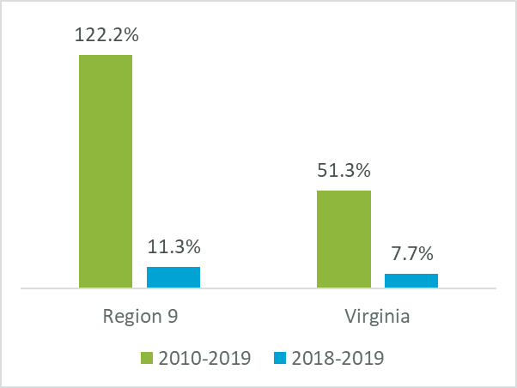
R&D
Expenditures
What is it? A measure of annual research expenditures by colleges and universities in the region across all sources of funding, such federal government, state government, industry, philanthropies/individual gifts and own institutional resources.
Why it matters? Provides a measure of the region’s academic institutions potential to drive innovation – the economic literature finds that proximity to academic research has strong spillovers to innovation by specific industry clusters in a region.
Academic R&D Expenditures (Millions)
Region 9 | 2010 | 2011 | 2012 | 2013 | 2014 | 2015 | 2016 | 2017 | 2018 | 2019 | Total
University of Virginia, Charlottesville | $276.3 | $398.1 | $383.4 | $385.8 | $358.6 | $373.2 | $397.5 | $469.7 | $551.8 | $613.9 | $4,208.2
Academic R&D Expenditures, Top 5 Disciplines
Growth in Academic R&D Expenditures
Field | R&D Expenditures, 2010-19 (Mil) | % of Total
Health Sciences | $1,638.5 | 38.9%
Biological and Biomedical Sciences | $1,001.8 | 39.0%
Education | $184.0 | 11.7%
Other Engineering | $119.0 | 8.6%
Physics | $103.9 | 8.2%
Sources: National Science Foundation (NSF) Higher Education Research and Development (HERD) Survey; TEConomy calculations.

Slide 15
Patents Invented in the Region
Total Patents, 2010-20
What is it? Patents are a primary way in which inventors are able to protect their innovations in products from being replicated.
Why it matters? By focusing on patents generated by residents we are able to more accurately gauge the region’s capacity to generate technology innovations. The patent classes help identify specific areas of technology innovation taking place in a region.
Region 9 | 2010 | 2011 | 2012 | 2013 | 2014 | 2015 | 2016 | 2017 | 2018 | 2019 | 2020 | Total
Patent Counts | 220 | 236 | 291 | 246 | 308 | 281 | 258 | 308 | 297 | 324 | 306 | 3,075
Technology Class Area | Number of Patents, 2010-2020
electrical digital data processing | 401
data processing systems or methods, specially adapted for administrative, commercial, financial, managerial, supervisory or forecasting purposes | 241
transmission of digital information, e.g. telegraphic communication | 240
diagnosis; surgery; identification | 165
preparations for medical, dental, or toilet purposes | 102
investigating or analysing materials by determining their chemical or physical properties | 86
image data processing or generation, in general | 69
card, board, or roulette games; indoor games using small moving playing bodies;video games | 68
devices for introducing media into, or onto, the body | 61
pictorial communication, e.g. television | 57
Source: U.S. Patent & Trademark Office data from Derwent Innovation; TEConomy calculations.
Notes:
Re

Slide 16
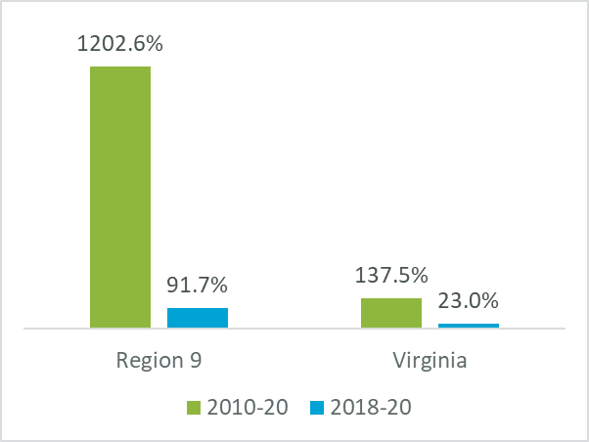
Venture Capital Investments
What is it? Venture capital represents equity investments made to emerging technology companies that offer high growth potential to generate sizable returns on that equity investment.
Why it matters? Venture capital investments are a direct measure of innovation activity taking place in a region. Beyond the number of deals and investment taking place on an annual basis, it is important to also consider the stage at which investments are taking place to ensure a robust pipeline of emerging ventures being formed and gaining scale in a region.
Venture Capital Activity
Region 9 | 2010 | 2011 | 2012 | 2013 | 2014 | 2015 | 2016 | 2017 | 2018 | 2019 | 2020 | Total
Deal Counts | 8 | 10 | 11 | 28 | 21 | 20 | 45 | 38 | 26 | 44 | 30 | 281
Investment Totals (Millions) | $12.0 | $30.3 | $16.6 | $54.0 | $42.2 | $17.4 | $45.4 | $109.6 | $81.2 | $77.2 | $155.7 | $641.4
Region 9 | Pre-Seed | Angel | Seed | Early Stage | Later Stage | Total
Deal Counts | 89 | 54 | 38 | 53 | 47 | 281
Investment Totals (Mil) | $1.5 | $89.8 | $32.9 | $171.7 | $345.5 | $641.4
Growth in Venture Capital Investment
Source: PitchBook Data, Inc.; TEConomy calculations.

Slide 17
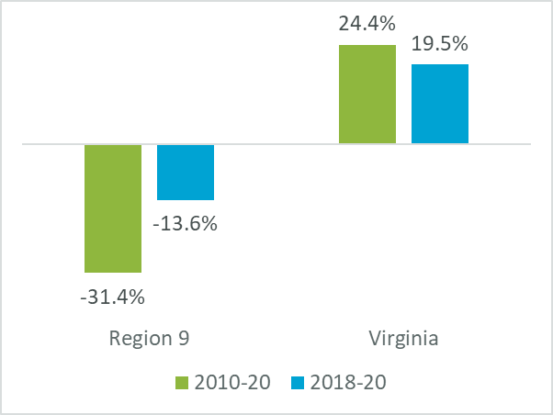
Federal Small Business Innovation Research (SBIR) Grants
What is it? The federal Small Business Innovation Research (SBIR) program is a source of innovation funding for emerging technology companies. The SBIR program encourages small businesses to undertake technology commercialization by requiring federal agencies with extramural R&D budgets that exceed $100 million to allocate 2.5 percent of their R&D budgets to the SBIR program. Each federal agency involved in the SBIR program then issues requests for proposals on topics reflecting their technology needs and interests, and competitively awards SBIR grants based on the technical merits and commercialization potential in a phased approach.
Why it matters? SBIR awards are another direct measure of innovation activity taking place in a region by small businesses.
Small Business Innovation Research Awards
Region 9 | 2010 | 2011 | 2012 | 2013 | 2014 | 2015 | 2016 | 2017 | 2018 | 2019 | 2020 | Total
Award Counts | 44 | 41 | 36 | 40 | 45 | 41 | 30 | 32 | 26 | 33 | 23 | 391
Award Amounts (Millions) | $12.8 | $23.8 | $10.9 | $19.2 | $21.3 | $26.9 | $15.7 | $19.2 | $10.1 | $19.3 | $8.8 | $187.9
Growth in SBIR Award Dollar Totals
Source: www.SBIR.gov; TEConomy calculations.

Slide 18
Regional Use of SBA Loans
What is it? U.S. Small Business Administration (SBA) 7(a) loans are that federal agency’s primary program for financial assistance to small businesses across the nation. These loans are typically issued by private lenders based on SBA guarantees of 75% to 85% with amounts not to exceed $5 million. Small businesses must demonstrate good credit/mgmt./ability to repay. Proceeds can be used for a variety of purposes: startup costs, buying land/buildings/equipment, new construction, working capital, and seasonal lines of credit.
Why it matters? SBA 7(a) loan activity is a measure of how active regional small businesses in traded sectors are in seeking to grow their operations. It also helps measures availability of capital to small businesses in the region since lending in the SBA 7(a) program often is through local lending sources.
Region 9: SBA 7(a) Loans and Loan Amounts, Cumulative Totals 2010-20
Industry Clusters | Co's Receiving Loans | Total No. of Loans | Total Loan Amounts ($ Millions) | % of Total Loan Amounts
Total, All Traded Sector Industries | 128 | 138 | $56.3 | 100%
Agriculture & Food Processing | 22 | 27 | $12.8 | 22.7%
Business Services | 26 | 29 | $5.8 | 10.2%
Energy, Natural Resources, & Finished Products | 4 | 4 | $0.3 | 0.6%
Engineering, R&D, Testing & Technical Services | 3 | 3 | $0.4 | 0.7%
Financial & Insurance Services | 4 | 5 | $3.3 | 5.8%
Information Technology & Communications Services | 10 | 10 | $1.6 | 2.8%
Life Sciences | 4 | 4 | $0.7 | 1.2%
Manufacturing | 20 | 20 | $7.9 | 14.0%
Transportation, Distribution and Logistics | 13 | 13 | $4.5 | 8.0%
All Other Traded Sectors | 22 | 23 | $19.1 | 33.9%
Source: TEConomy analysis of SBA loan data reports.

Slide 19
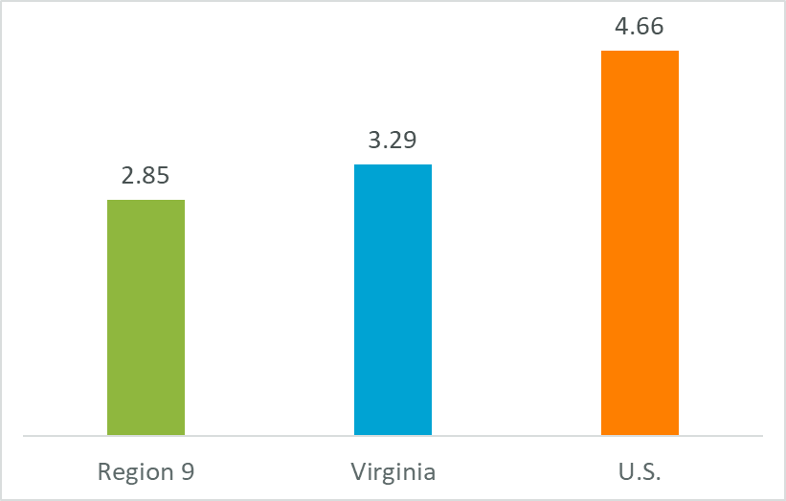
Regional Utilization of SBA Loans vs. State & U.S. Totals
What is it? By normalizing SBA 7(a) loans to traded sector small businesses by the number of traded sector establishments, it is possible to compare the level of lending activity in a region to that of the state and nation.
Why it matters? High utilization of SBA 7(a) loans in a region suggests that the region has a growth-oriented traded sector small business base and/or good access to capital, while low utilization suggests a region’s small businesses are not seeking to grow and/or are having trouble accessing capital.
SBA 7(a) Loan Counts, Traded Sector Companies Per 1,000 Establishments, Avg. 2018-2020
Source: TEConomy analysis of SBA loan data reports.

Slide 20
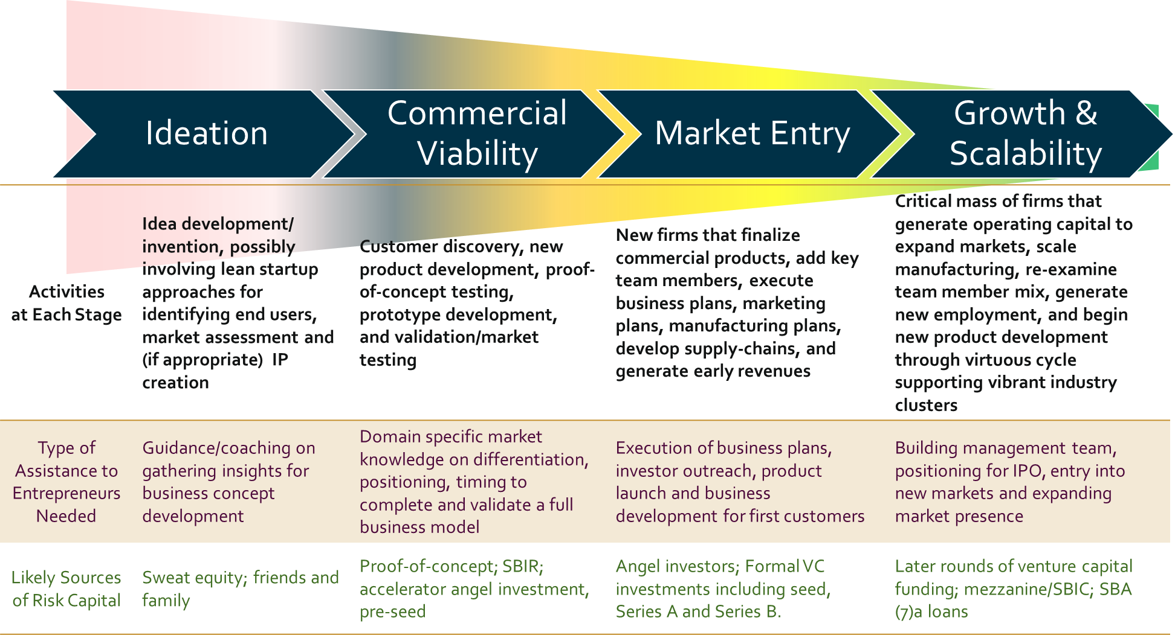
Discussion – Implications Across Entrepreneurial Development Stages For Traded Sector Industries in Region 9
Entrepreneurship is a process involving an interconnected set of development stages supported by public and private resources and services that generates successful new startup businesses to drive regional economic growth. If a region is underperforming in any stage of entrepreneurial development, then it will not realize its full potential in traded sector industry development.
Stages of Entrepreneurial Development

