Slide 1
Partners for Better Communities

Slide 2
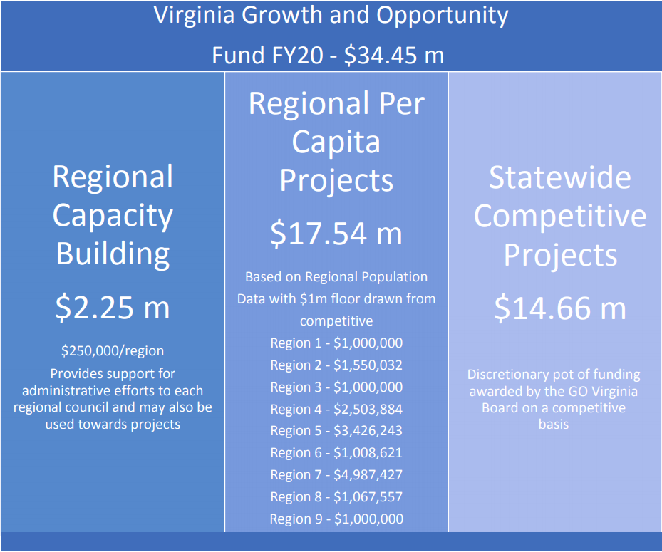
PY20 Statewide Competitive Funds have been repositioned for a new grant type.
Partners for Better Communities

Slide 3
Economic Resilience and Recovery program
The Basics:
Each region can apply for UP TO $1.0M for projects that directly respond to the COVID-19 crisis
Each region will have a year to access these special funds
Focus on traded sectors, but flexibility for prioritized locally-traded sectors as identified by Regional Councils
$5.66M will be reserved for projects with statewide impact
Each region may access up to $300k of their $1.0M using a FastAccess application process. Apps up to $100k can be administratively approved by DHCD after Regional Council approval and go directly to contract
Larger requests will require the approval of the GOVA state board (May 22 deadline, June 23 meeting)
Relaxed (2:1) match and no local match required
Partners for Better Communities

Slide 4
Economic Resilience and Recovery program
Regional Activities:
Two or more localities – think region-wide or sub-regions
Actionable sector-based strategies to mitigate the economic impact of the crisis today or aid in recovery
Priority industry sectors OR highly-impacted locally traded sectors
Workforce, Cluster Scale-Up, Start-Up Ecosystem
Partners for Better Communities

Slide 5
Economic Resilience and Recovery program
Encouraged Activities (examples – NOT exhaustive):
Expanding regional capacity to coordinate and deliver business support services such as access to financing, including crowd-sourcing platforms
Expanding use of the internet for e-commerce to increase sales
Identifying and connecting critical suppliers of goods and services to reduce service and production disruptions
Expanding testing capabilities to encourage safe return-to-work strategies
Maintaining and managing a remote workforce to keep people employed and productive
Developing new/expanded industry-aligned on-the-job training program that would meet critical need
Facilitating job/training program placement in partnership with existing employers or workforce intermediary needs
Projects should not duplicate existing efforts but may expand capacity or support unmet needs in the region.
Impact should be near-term
Partners for Better Communities

Slide 6
Economic Resilience and Recovery program
Discouraged Activities:
Planning ONLY applications
Partners for Better Communities

Slide 7
Economic Resilience and Recovery program
Prohibited Activities:
Direct grants to businesses
Direct loans to small businesses or capitalizing revolving loan funds
Equity investments in firms
Partners for Better Communities

Slide 8
Economic Resilience and Recovery program
Flexibility Around:
Traded Sectors
Wages
Partners for Better Communities

Slide 9
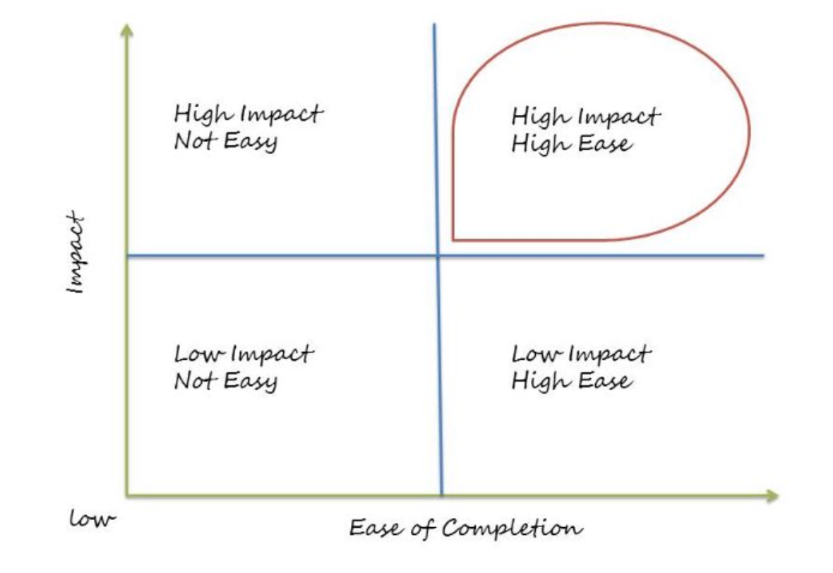
Economic Resilience and Recovery program
Regional Collaboration
Responsiveness to COVID19 Economic Impact
Sector-Based
Investment Strategy Focus
Potential Impact
Readiness
Timeline to Implementation
Partners for Better Communities

Slide 10
Economic Resilience and Recovery program
Roles
DHCD
Administers program at state level
Develops guidelines
Grant administration and oversight
GO Virginia Regional Councils
Administers the program at regional level
Engages partners, develops and executes strategies, establishes priorities & industry targets
Receives and approves applications for submission to DHCD
Regional oversight
GO Virginia State Board
Established the fund and match requirements
Review and approve applications in excess of $100K
Partners for Better Communities

Slide 11
Economic Resilience and Recovery program
What’s Next
Finalize Program Guidelines
What ropes do we need? Questions to answer?
Finalize Applications
ERR – FastAccess – Propose to use modified ECB app – received via e-mail (not CAMS)
ERR – Proposed to use modified Per Capita project application – entered into CAMS
Questions
Can we all use a common applications, once approved?
Can we check our project review and approval process to ensure we’re balancing the vetting with a speed-to-market mentality
Local participation still applies – what qualifies in a no local match scenario?
Program promotion and partner outreach
Roll for council members
Partners for Better Communities

Slide 12
Regular Per Capita Funds - Status
Modified match through Oct 18, 2020 (Board Policy #11)
PER CAPITA FUNDS
 | Total Match | Local Match
Enhanced Capacity Building | 2-1 | No Local Match Required
Regional Entrepreneurship Initiative | 2-1 | No Local Match Required
Sites (planning) | 2-1 | No Local Match Required
Sites (implementation) | 2-1 | No Local Match Required
Broadband (planning) | 2-1 | No Local Match Required
Broadband (implementation) | 2-1 | No Local Match Required
Project Implementation | 2-1 | No Local Match Required
Partners for Better Communities

